Slide 1
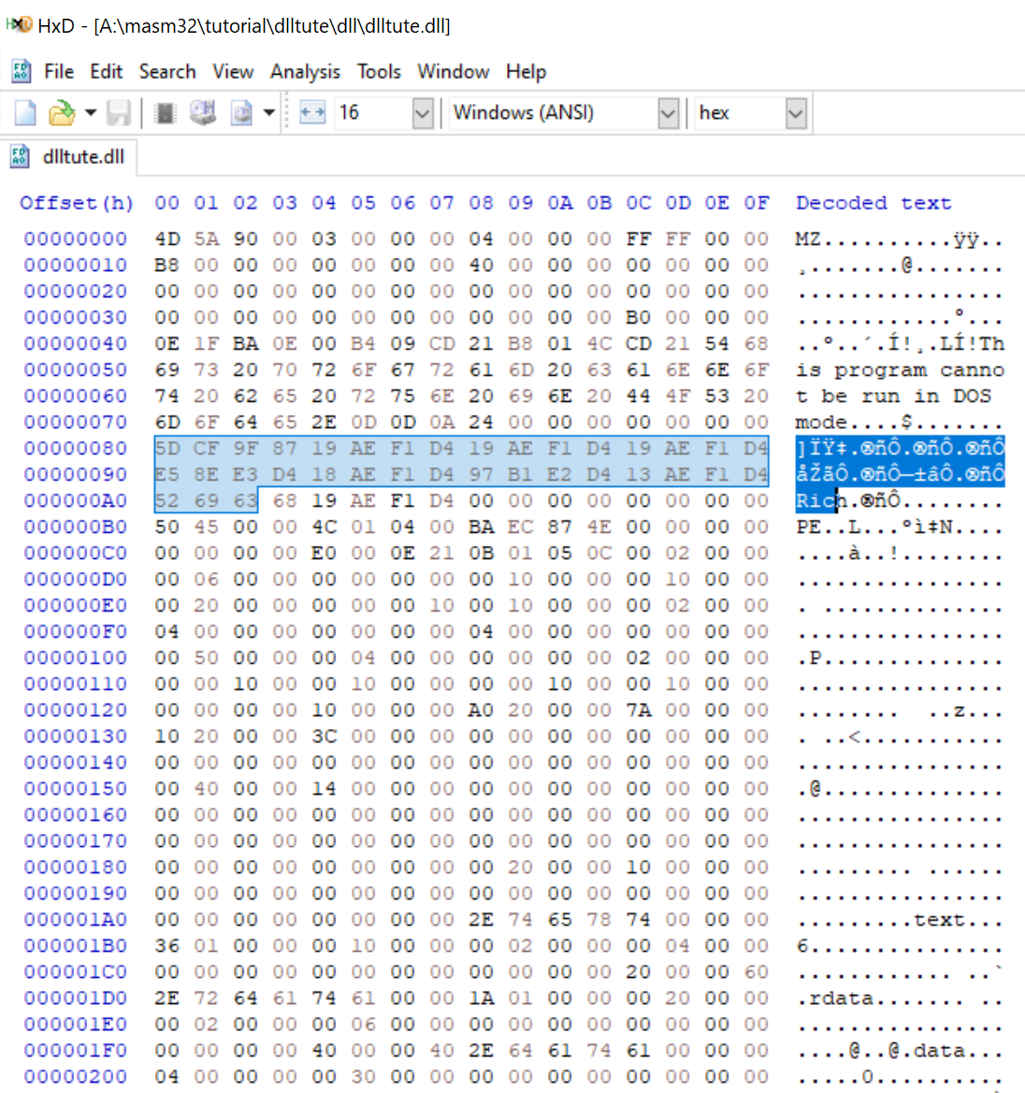
Reverse Engineering DLL’s
By “Average” Joe Giron

Slide 2
What we’re covering
What Is A DLL / History
How Do They Work / Run Code?
DLL Events
DLL Imports
DLL Exports
DLL Export Ordinals
Known DLL’s
Executable Manifests
DLL Search Order
App_Init / AppCert DLLs
Shared Memory Spaces & Windows Hooks
DLL Injection
Rundll32
Reversing (Finally)

Slide 3
Tools used:
IDA Pro
CFF Explorer
Pelles C compiler
X64dbg
Ghidra
Process Hacker

Slide 4
What is a DLL?
In the hey day of programming, space was limited. In DOS (remember that?), COM files were limited in size to a 64 kilobytes. If you wanted functionality, you had to statically link that shit. This means if you wanted something like zip functionality, it had to be embedded into the source. This of course drives up the size of the program. Every program has this problem. Statically linked code meant no 2 programs could share the same code.
Enter Dynamic linking. This changed everything as programs could share code making executables free from static linking and thus bringing down the sizes of programs. This modularity allowed other programs to cooperate with each other. This was the basis for the earliest version of windows to get a proper gui going.

Slide 5
How do DLLs load / run code?
1) Program A is written (duh), compiled as a DLL via a compiler flag. Functions are set to be ‘exportable’ which is a keyword set in the function prototype.
2) Program B is made and wants functionality from program A. Program A uses the internal Win32 function ‘LoadLibrary/LoadLibraryEx’, specifying the name / path of program A.
3) Program B calls GetProcAddress() and specifies either the name or ordinal of the DLL’s exported function.
4) Program B then creates a function prototype and calls said function.
There are a ton of ways to load DLL code, but this is traditionally the way we do it, via instantiation by another program.

Slide 6
DLL Events
Like a C program, DLL programs have a ‘main’ function, the one that is executed first. On a DLL, it is called ‘DLLMain’. This function will contain our events.
These events are fired off depending on how the DLL is initialized be it by thread instantiation or by simply loading the library. This can (and usually is) be blank in favor of just using DLL exports (more on this later).
If we are interested in running just the code within the DLL with no exports, we need only spawn a new thread or load a library for our code to run.

Slide 7
DLL Events 2
DLL_PROCESS_ATTACH - Code event that occurs when a process initializing the DLL calls LoadLibrary().
DLL_THREAD_ATTACH — Happens whenever a new thread is created in the process initializing the DLL
DLL_THREAD_DETACH — Same as above, but when a thread is destroyed.
DLL_PROCESS_DETACH – Code event that happens when an initializing process calls FreeLibrary().
I’ve found that the DLL_PROCESS_ATTACH event goes off several times despite LoadLibrary being called once. A Bug? Maybe.

Slide 8
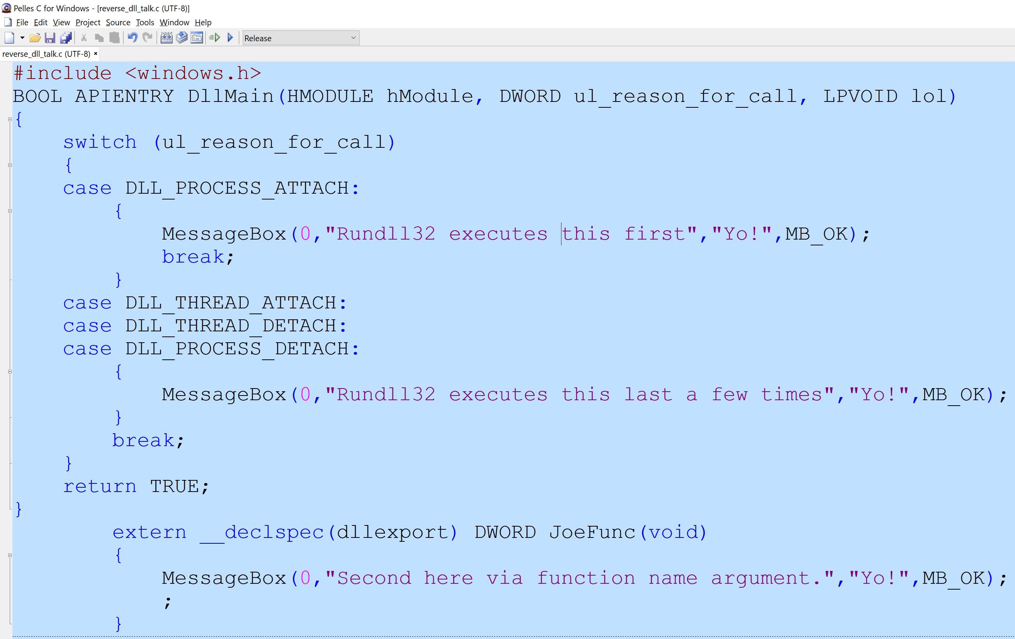

Slide 9
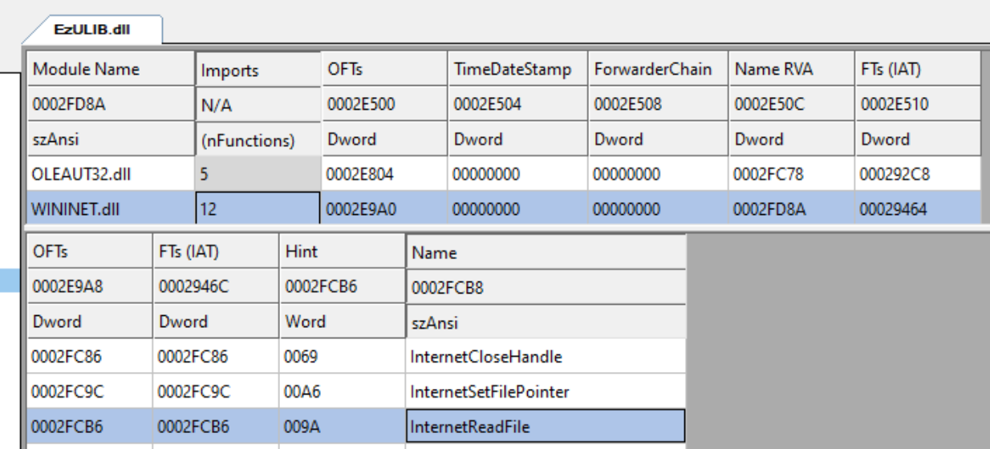
DLL Imports
Think of a DLL Imports as a table that contains all of the functions an exe or DLL is loading later.
Example:
My program needs to call the InternetReadFile() API. So, my imports table will have an entry for wininet.dll with the function InternetReadFile()specified within the import address table.
The Import address table is just a list of pointers to said API’s when loaded into memory. All the other crap not mentioned can again be the subject of another talk.

Slide 10
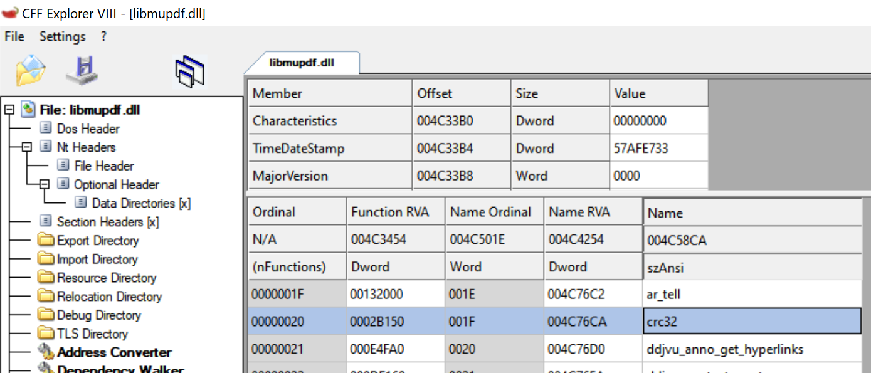
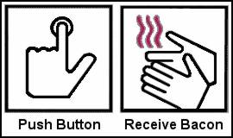
Dll Exports
A DLL can optionally, but usually provide what’s called an export. Essentially an exported.
Programs that use DLL files are mostly interested not in the event section, but rather the items exported.
Example:
We see the exported item “crc32” within the DLL libmupdf.dll We load the appropriate dll file, Get the address of the function by name or ordinal, then call it.
Functions can be called by either name or ordinal. The GetProcAddress API used in conjunction with LoadLibrary / LoadLibraryEx API allow programs to

Slide 11
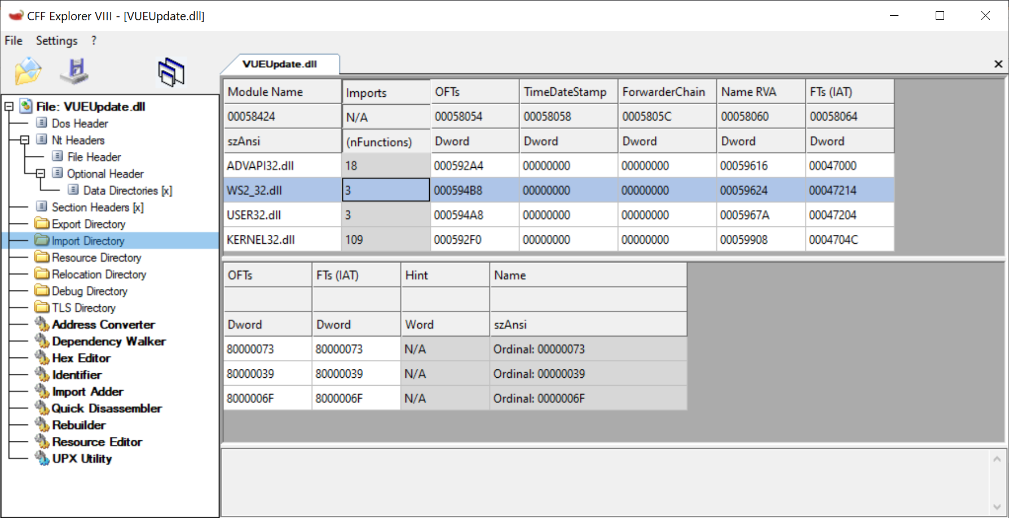
Dll Exports Names / Ordinals
There are 2 ways DLL functions are exported – by name and by ordinal.
Exporting by name makes sense as when a caller program invokes LoadLibrary / GetProcAddress as they need only use the string name of the function.
Exporting by ordinal means we export a function by a 32 bit value which is representative of a function. A bit more confusing.

Slide 12
Ordinals
Think of an ordinal as a numeric reference to a function. Rather than calling something by name, we call something by number. This can be considered a form of obfuscation, but not really.
Here’s an example. We see this program importing ordinal functions from ws2_32.dll (winsock) with no names, instead the numbers 00000009, 00000011, 00000012. Can we decipher this? Trivially.

Slide 13
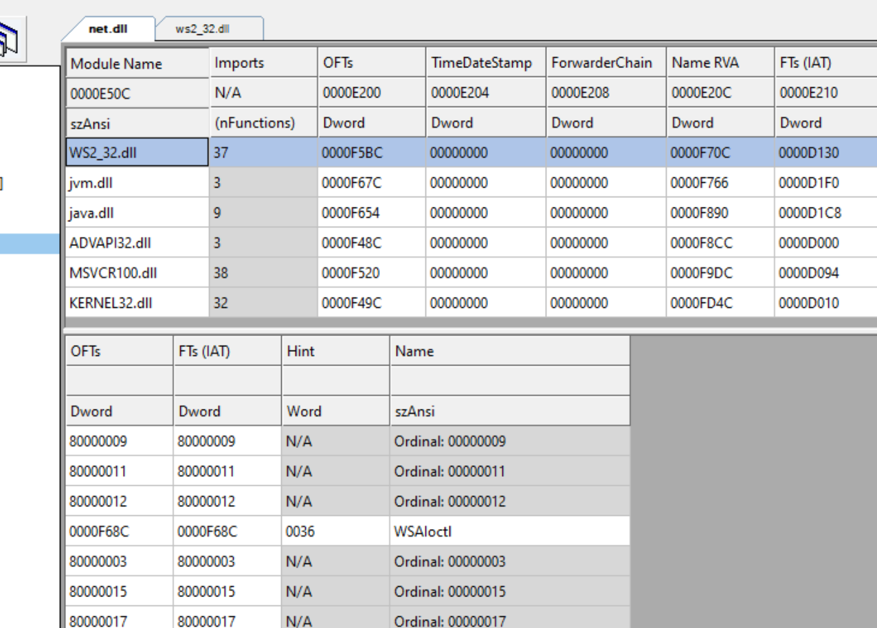

Slide 14
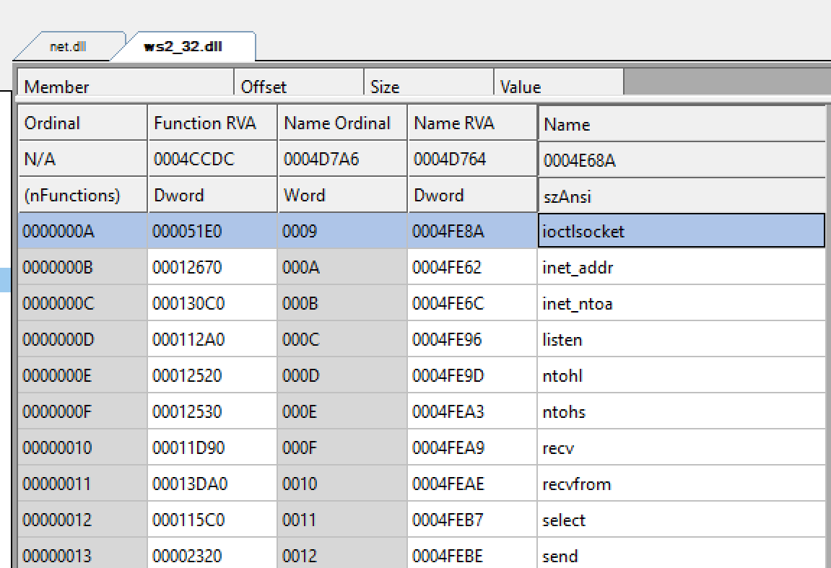
When we look at the same functions from the EXPORTS tab of ws2_32.dll, the ones we are importing, we need only look at the ordinal number and matcht them with the name. So 00000009, 00000011, 00000012 line up with
Ioctlsocket, select, and send. So much for obfuscation.

Slide 15
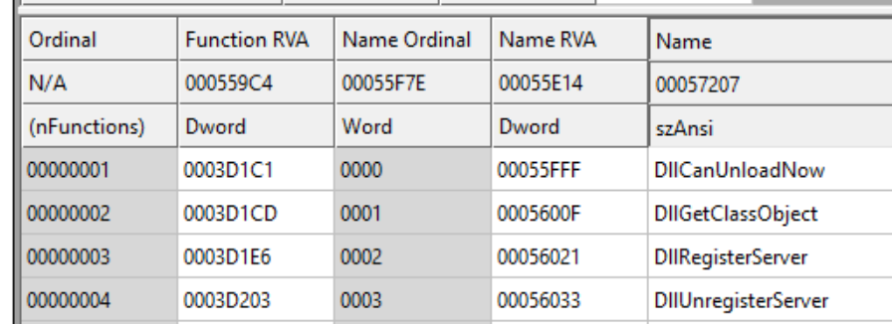
No exports, just these. WTF?

Slide 16
These are OLE COM files (not to be confused with DOS COM files). OLE stands for Object Linking and Embedding. COM stands for Component Object Model. They are used in conjunction with regsvr32.exe to register COM objects and ActiveX controls for stuff. I ain’t touching this rabbit hole. If you’re interested(a madman), check out oleview.exe that comes with the windows development kit / Visual Studio.

Slide 17
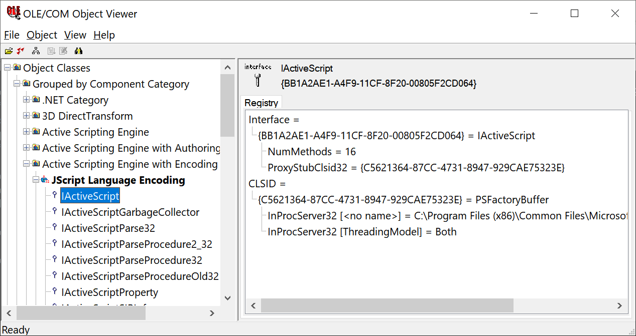

Slide 18
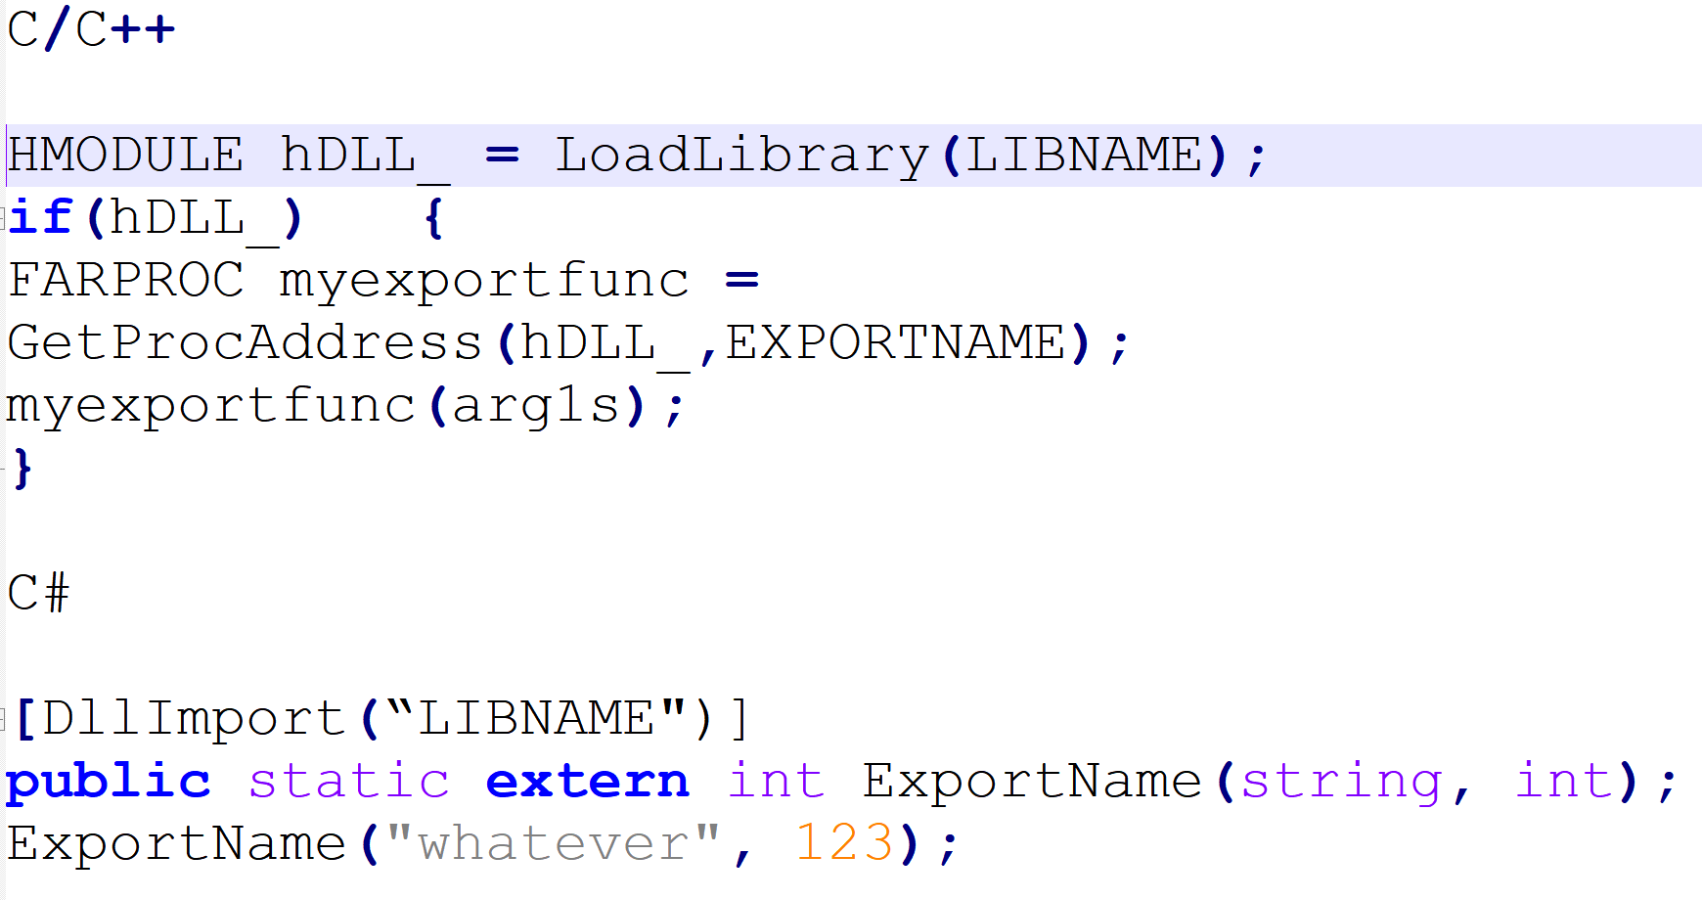
Calling Our DLL Code
As I said before, there’s many ways to call our DLL code, but the most traditional way is via instantiation by a program making use of the LoadLibrary and GetProcAddress Win32 API’s. I’m using C, but this works with C++ as well. I’ve also included C#.
Also there’s Rundll32.exe, we can use that too for calling our DLL code.

Slide 19
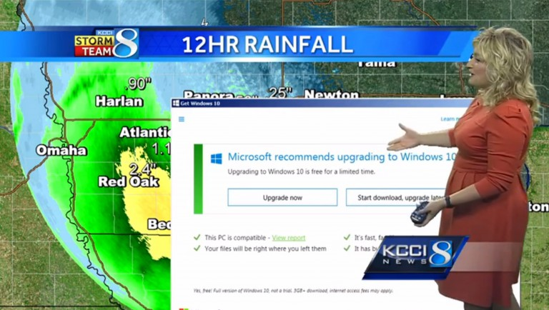
Rundll32.exe? What?
Rundll32 is used for running exported DLL entries. Useful for running, but we would need to know the argument information to pass.
This is also useful for when we don’t want to write a wrapper program to call our DLL functions.
Syntax (can be from run box too)
Rundll32.exe joe.dll,dllfunc,dllfuncarg

Slide 20
RunDll32.exe execution order
1) DLL_PROCESS_ATTACH
2) any exported function names specified as arguments to rundll32
3) DLL_PROCESS_DETTACH
Thread events are ignored because rundll32.exe instantiates the DLL by spawning a new process.

Slide 21
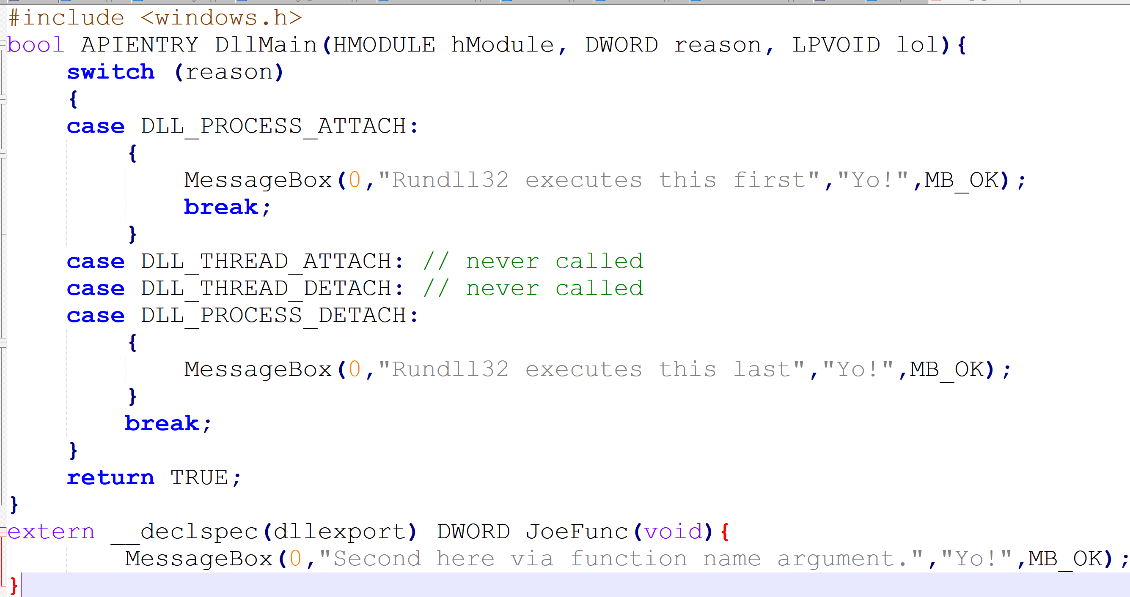

Slide 22
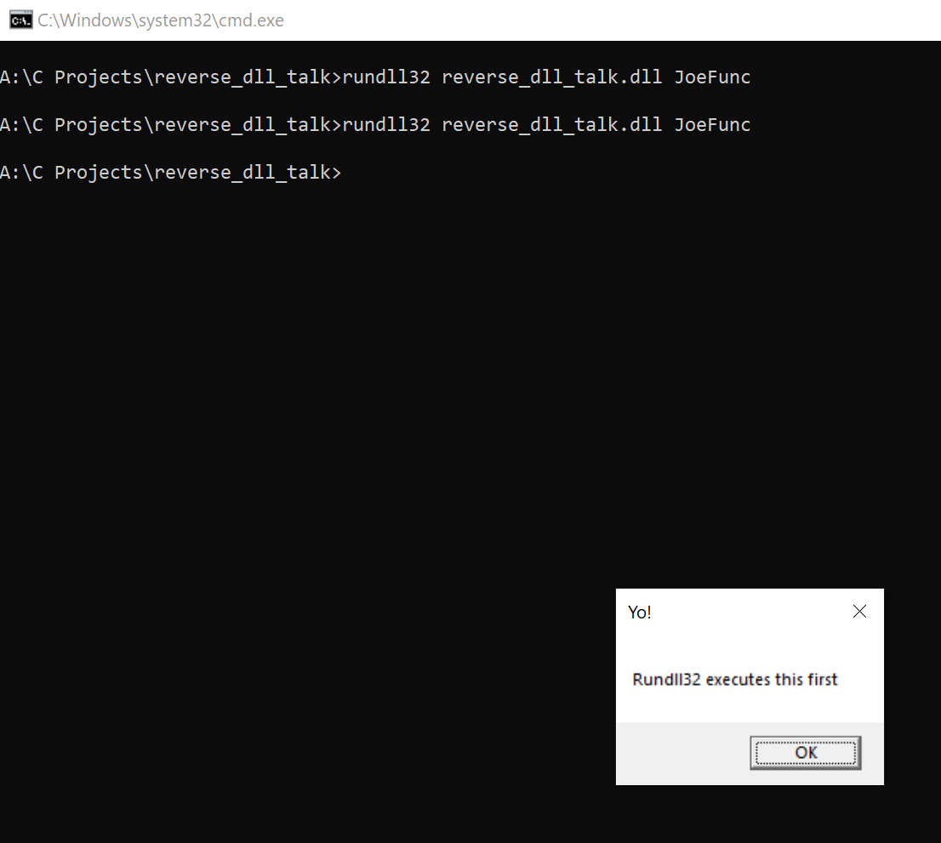
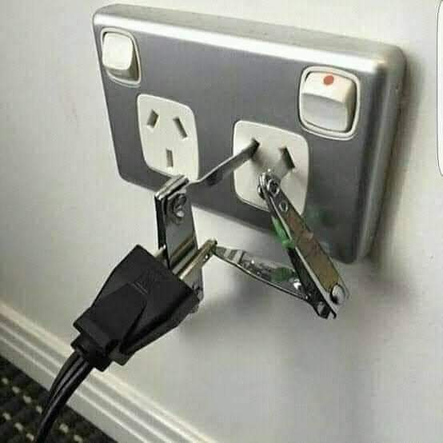
EZ PeeZee

Slide 23
DLL Search Order
DLL files loaded with loadlibrary / loadlibraryex have a certain search order. This means DLL files are loaded in a certain order.
DLLs with the same name loaded in memory
Items listed in Manifest file
KnownDLLs registry entry
Launch folder
Current Directory
System folder (windows, system32, etc)
PATH environment variables

Slide 24
Known DLL’s
Known DLL’s registry entry HKEY_LOCAL_MACHINE\SYSTEM\CurrentControlSet\Control\Session Manager\KnownDLLs
Known DLL’s are DLL’s that are loaded from the system directory first so that programs cant screw things up with their own copies of say, kernel32.dll. This is also a minor security restriction. I say minor because the known DLL’s list is far from complete. There are a lot of system32 DLL’s used all over the place that aren’t in the KnownDLL’s key.

Slide 25
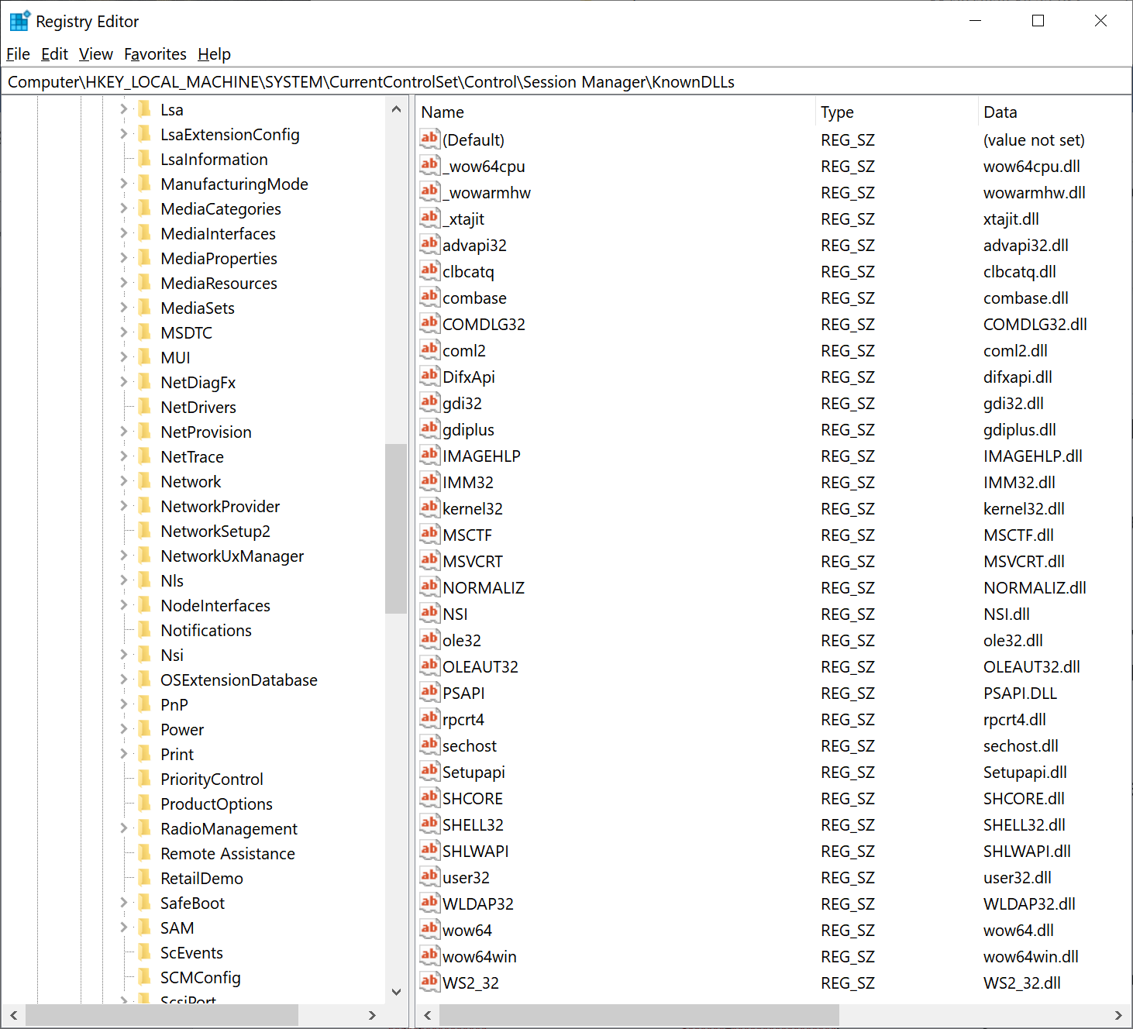
Hard to read, but it’s a list of DLL’s that are loaded in the system directories first, superseded only by a manifest file. The vulnerability here lies in DLL’s commonly used by everything, but not in the list. There’s so many.

Slide 26
Exploiting The Search Order
If we control the directory and the exe loading a file runs elevated / signed, then our code within the DLL also runs signed / elevated. See the problem here? If we control the DLL that’s loaded, we control the context. Our unsigned code is now signed, and our unelevated code is now elevated.
This has been exploited (by me) all the time. All these vulns and no CVE’s to go with them. I wonder if they ever fixed the one I mentioned in Fiddler?

Slide 27
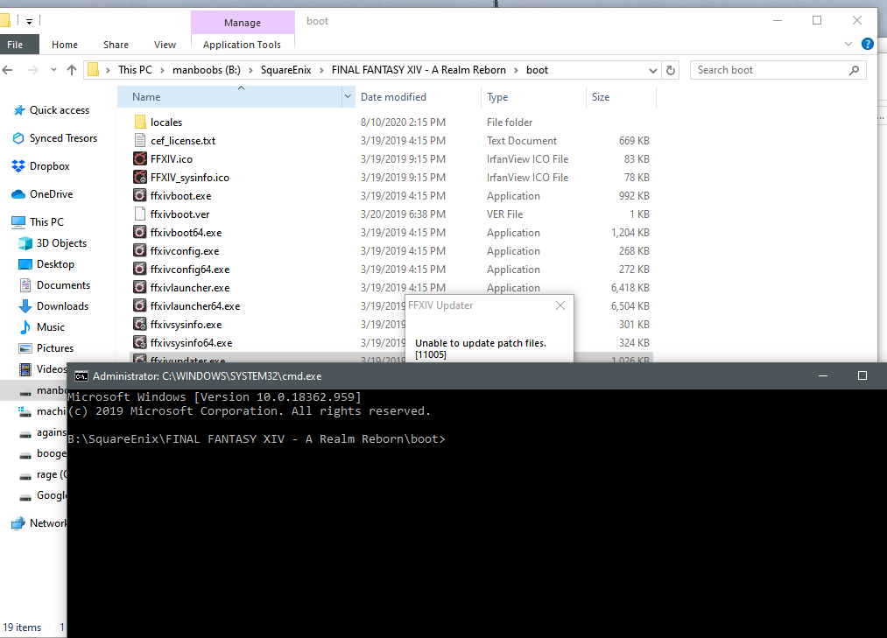

Slide 28
DLL Redirection (Manifests)
A manifest file is an XML file embedded within newer executables that tells Windows about executable actions or conditions to perform prior to being run. A relatively new addition, this adds a level of complexity and security to Windows.
The element we’re interested is <file>. This XML entity specifies DLLs to load that are at the top of the DLL search order. The one that skips all, regardless of other paths. You can even use your own kernel32.dll if you wanted to, just specify it in the manifest file.

Slide 29
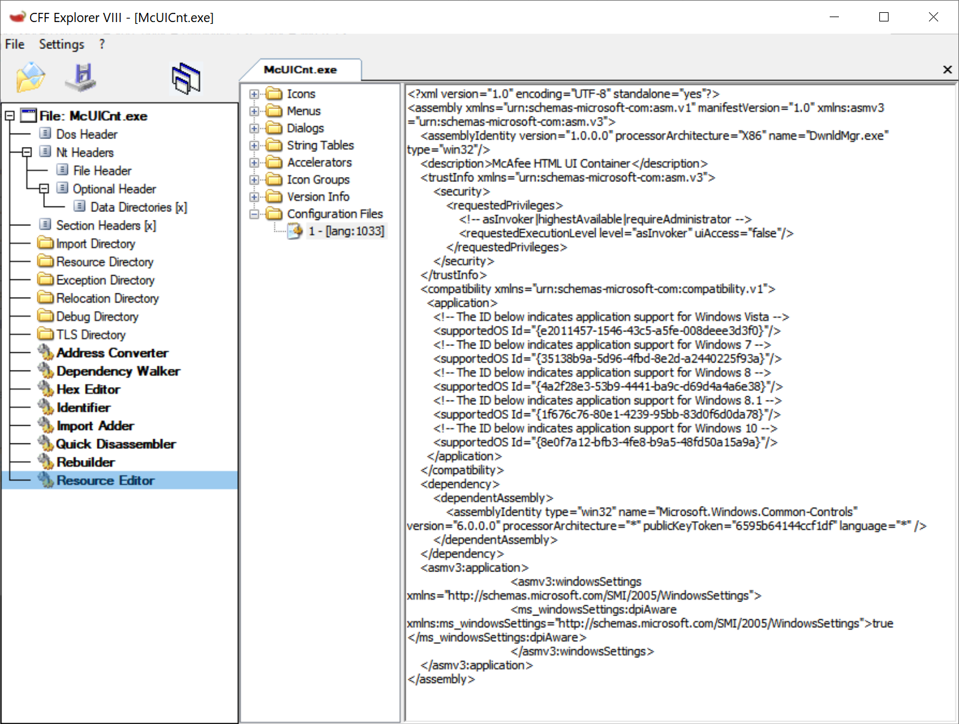
Manifest file within McAfee executable
Note the admin privileges requested, supported OS’s, and assembly dependencies.
It is hard to exploit this.

Slide 30
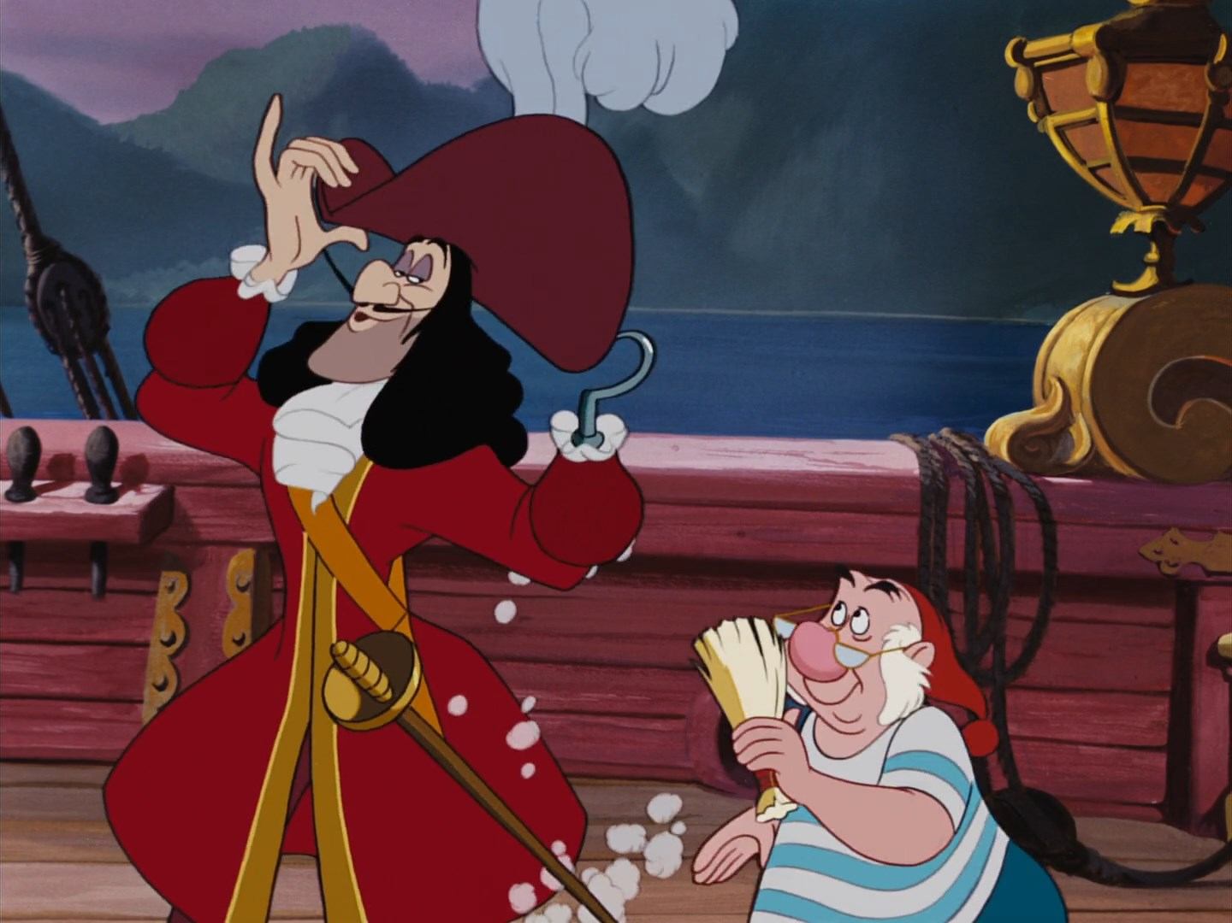
Windows Hooks
Windows provides functionality to alter or monitor the subsystem of the Windowed environment. The function SetWindowsHookEx allows the programmer to monitor and or alter window messages. The function registers a callback function which is called whenever a certain window event occurs.
Examples of window events for callbacks include WH_KEYBOARD which handles keyboard stuff, WH_MOUSE which handles mouse activity, and WH_CBT which handles windows being created and destroyed.
Normally a program can only hook Windows messages, unless of course we make use of shared memory in a DLL file and implement with said hooks.

Slide 31
Shared memory spaces
DLL’s like EXE’s share only the address space of the program calling them. If we want our DLL to have access to all programs, we need to specify functions within the DLL shared in the compiler.
In the case of hooking, we would need our hooks global.
Why would we do this? Maybe a keylogger? After all, we would want to look at every keystroke across all programs, right?
Anyways, this is how we specify shared code. When we load our DLL, the DLL has essentially been ‘Injected’ into the address space of other programs.
#include <windows.h>
#pragma data_seg("SHARED")
#pragma comment(linker, "/SECTION:SHARED,RWS")
HHOOK hhk = NULL;
HINSTANCE hinst = NULL;
#pragma data_seg()
If you want to see this in action, check out my keylogger I wrote.
https://github.com/joseph-giron/Remote-Keystroke-Logger

Slide 32
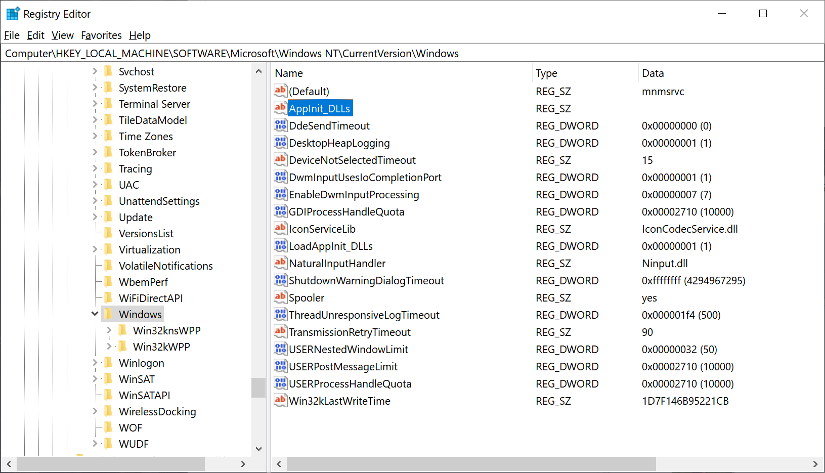
Windows has some interesting functionality to allow DLL's to be loaded all applications that include user32.dll. This can of course cause some stability issues, but over all provides a way to hook all windows api's system wide. Think of the madness that can cause.
This used to be popular with malware, but has since gone by the wayside. This “feature” is also off by default now.
App_Init DLLs

Slide 33
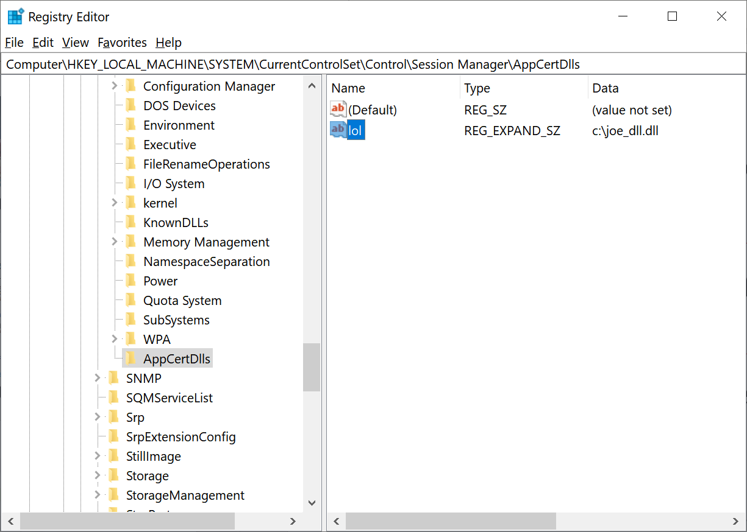
Another way to ensure our DLL is included in every process. Unlike AppInit which is limited to programs that utilize user32.dll, AppCert DLL’s get loaded everywhere.
This entry is missing from Windows 7 on, but can be re-added. Just re-add the key, add a new name and put in the path. Done.
AppCert DLLs

Slide 34
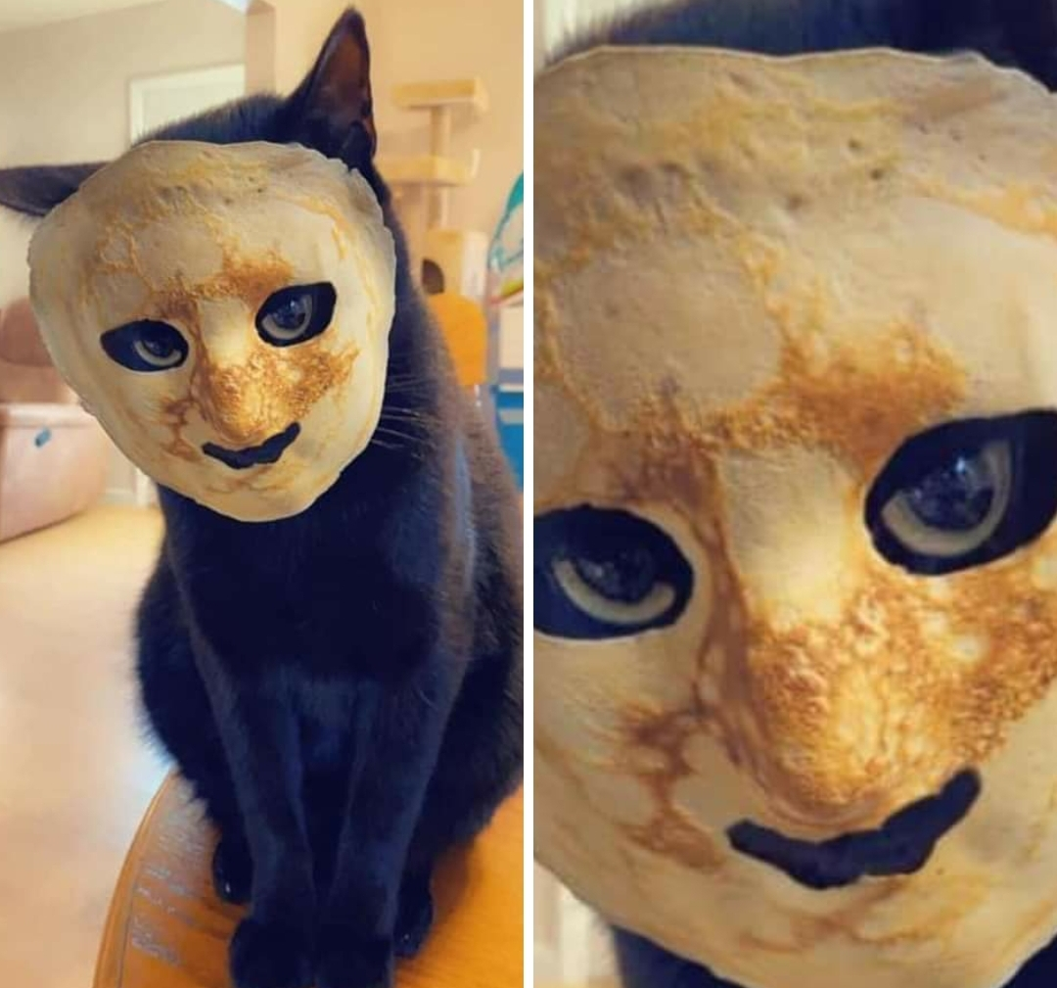
DLL Injection 2
The other way we can inject our DLL into another process’s address space is via the use of the Win32 API’s CreateRemoteThread(), NtCreateThreadEx(), and RtlCreateUserThread(). It basically comes down to opening the address space of another process, allocating memory in said process, writing the process memory of said process, then executing code in said process.

Slide 35
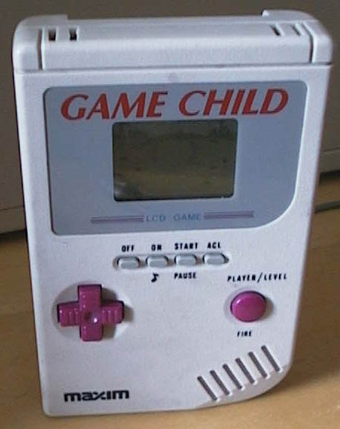
Sound hard? Because it is hard
.
We First need access to open a process which means we need to assign ourselves the SeDebugPrivilege token, then we need to call VirtualAllocEx which allows us to specify memory in another process, then we need to write the process memory via the API WriteProcessMemory(), then call said code with the 3 API’s I mentioned earlier.
This same stuff is how we preform process hollowing by the way, but that’s a subject of another talk. In fact, the last 2 slides can represent an entire talk.
Sorry about that.

Slide 36
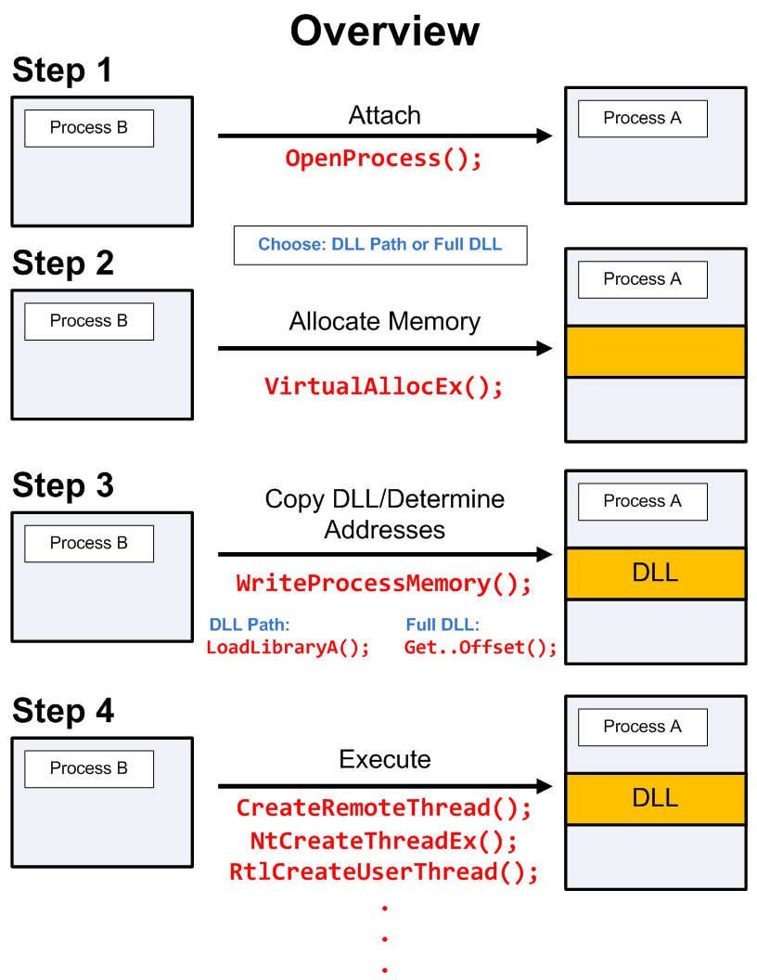

Slide 37
DLL ETC info
The last thing to touch on is kernel32.dll, advapi.dll and ntdll.dll. These are the core components of Windows. These contain the APIs and functionality which Windows runs on. Everything from memory allocation to process creation and access control is all done by these 3.
Many Windows API functions(not all) stem from Kernel32, user32, and advapi32.dll. Ntdll.dll is considered the ‘low level’ wrapper. Functions here are named by either ‘Nt’ or ‘Zw’. Example: NtWriteFile, or ZwCreateFile.
Much of the ntdll.dll program is undocumented. Projects like ReactOS make great strides in reversing ntddl.dll, but more work is needed.
I don’t want to jump down this rabbit hole. If you’re interested, check out ReactOS.

Slide 38
Yawn……
I know that was a lot of crap to go over. This is all essential to reverse engineering things – knowing about the thing we’re reversing at a deeper level.
What we know now is that DLL files can be reversed dynamically by looking for LoadLibrary/LoadLibraryEx calls that specify the DLL name.. We know that the exported DLL functions imported by an exe that utilize this dll will use the API GetProcAddress with either the name or ordinal of the function .
Code will run under the context of a DLL export with events running first / last when loaded or unloaded ( DLL_PROCESS_ATTACH, etc).

Slide 39
Reversing The DLL Exports

Slide 40
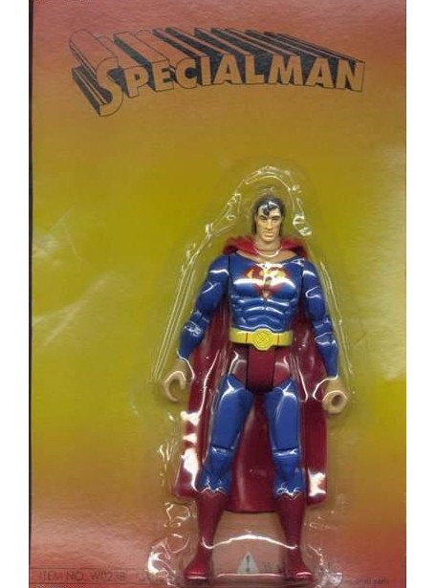
Ghidra or IDA? Why not both?
In my honest opinion, IDA is my go-to. Unfortunately, its expensive, but tried and true, and not made by the NSA.
Ghidra is nice for the free built in decompiler that works in multiple architectures. IDA has them too, but again, expensive.
IDA has a free* version floating around the net that’s just as good as the paid version.
Ghidra is free too, but again, NSA.

Slide 41
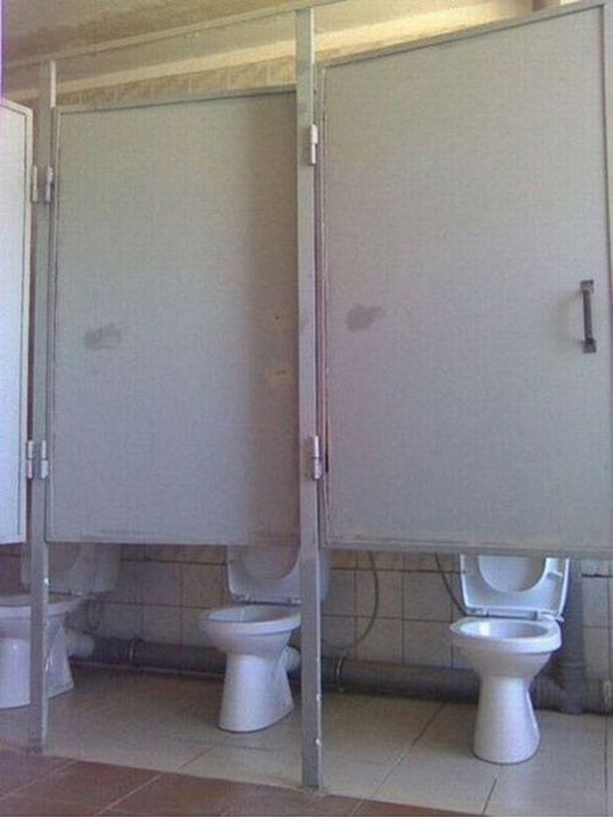
PoC or GTFO
Here we have McAfee’s McUtil.dll, borrowed from the shovel-ware they throw on new computers or that you haphazardly agree to install when installing something else / utterly useless AV. Next we have a DLL cpuutil.dll, used for finding hardware information pilfered from Asus. Finally, EzULIB.dll, a second Asus DLL. This is one that’s used for downloading updates.
Now let’s reverse some shit already.

Slide 42
cpuutil.dll from the CPUID company

Slide 43
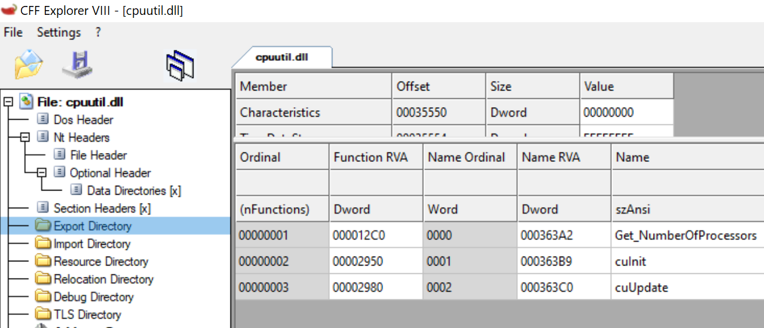
Lets see…
Only 3 entries. Lets check out Get_NumberOfProcessors. What does Ghidra say?

Slide 44
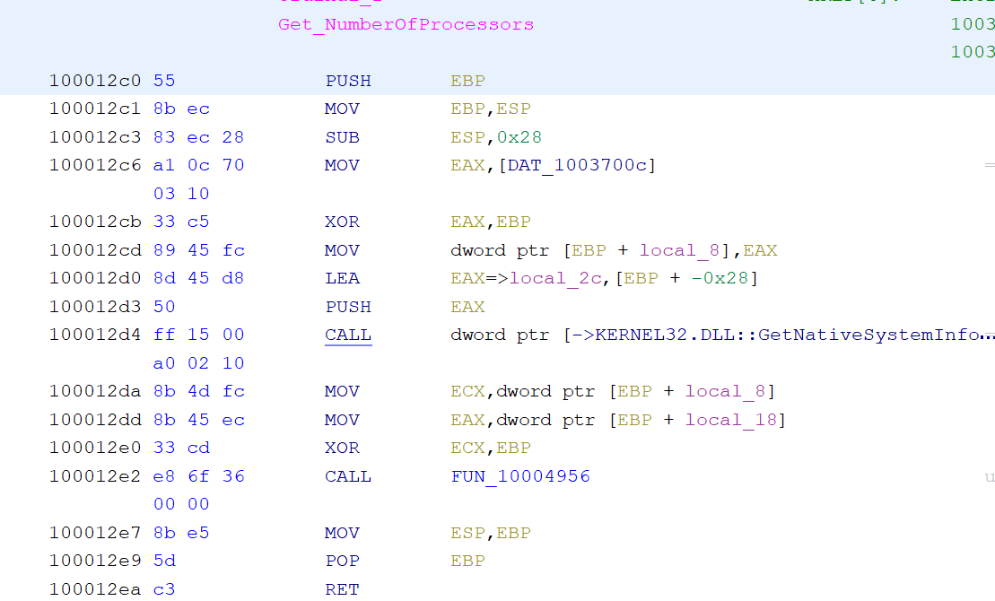
Pointer To Structure
Push address of structure to stack
Win32 API call for getting system information
Exception Handler (ignore)

Slide 45
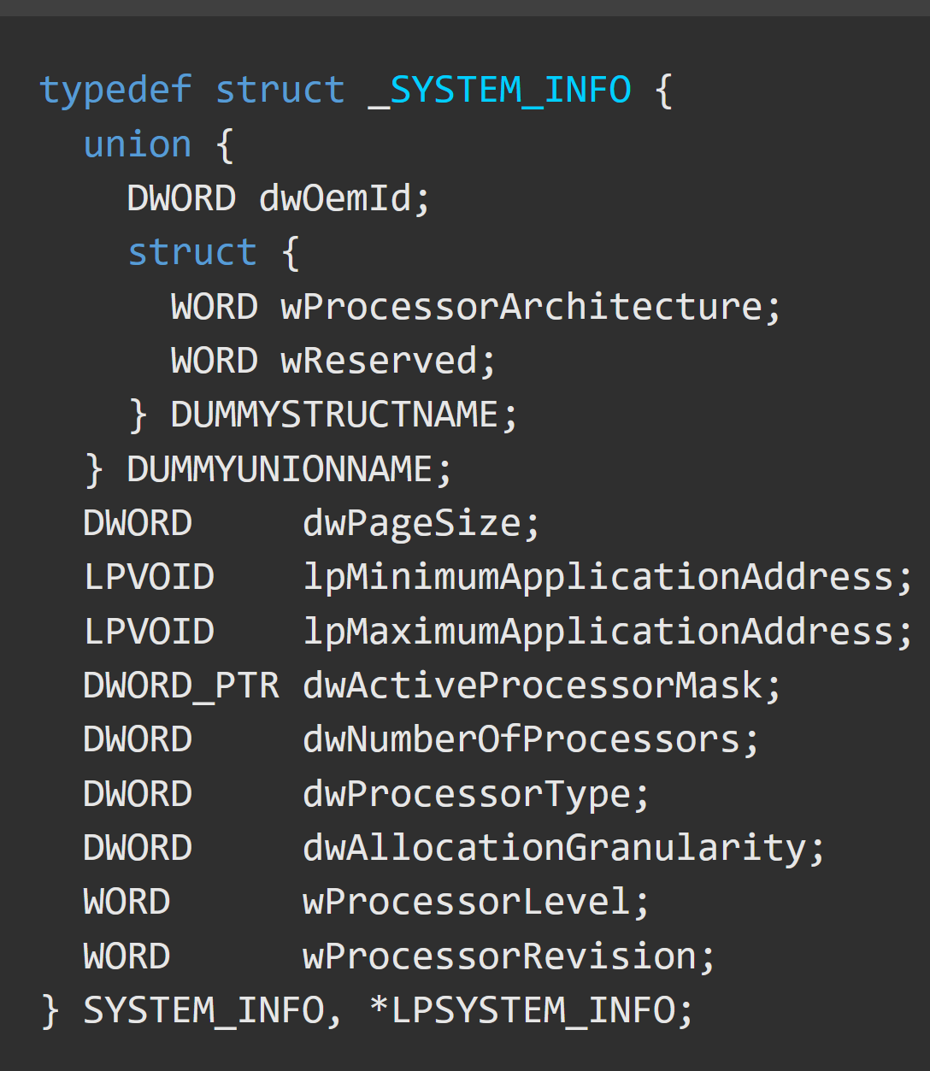
Rarely is it this easy, but we’ve caught a break.
According to MSDN the GetNativeSystemInfo function which takes a structure argument SYSTEM_INFO which it then populates with the stuff we want.
The only thing we want is the 7th item in the filled structure after calling out API. DWORD dwNumberOfProcessors. Our Exported DLL Function must call this and return an integer – the number of processors on a given system. No debuggery required. Yay!

Slide 46
McDeleteFilesDeferedW from McUtil.dll / McAfee

Slide 47
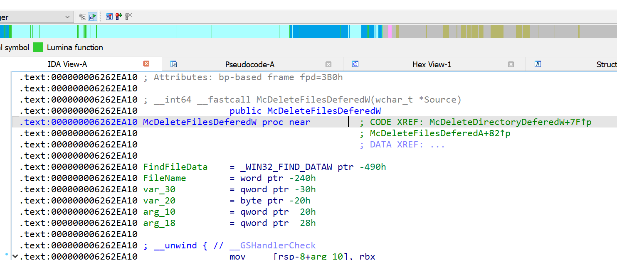
First, lets look at the export. IDA says it takes a single argument, a wide string. We see 2 other exported entries call this function. Then we see a structure for _WIN32_FIND_DATAW which according to MSDN is the structure you initialize prior to calling FindFirstFile(). Yep, all that from the first line

Slide 48
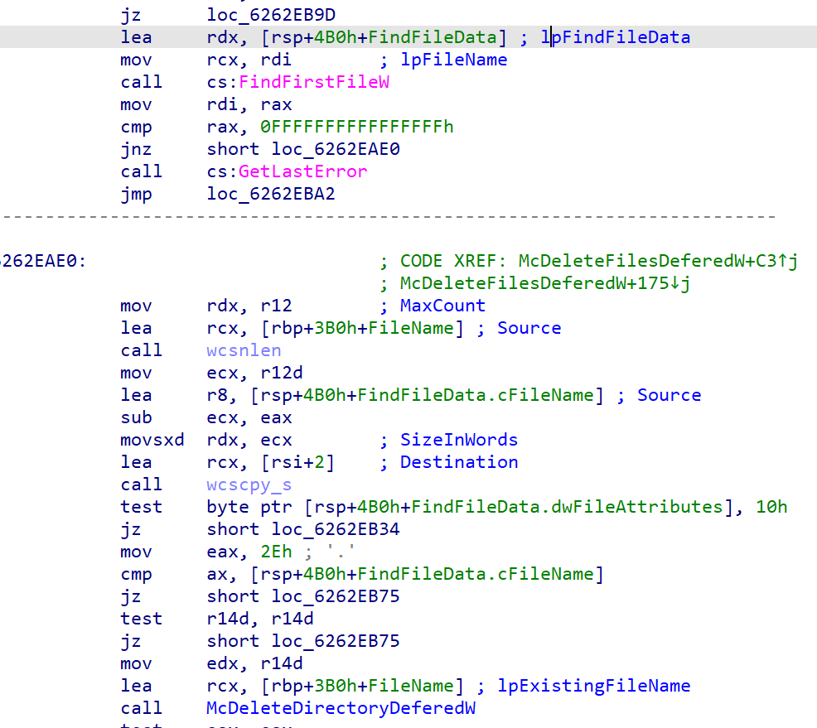
Further down we see that data structure from before, as well as our file name argument. And sure enough, they are being sent to the FindFirstFile function.
If we’re successful in finding files, then we call to McDeleteDirectoryDeferedW which goes through each item in a directory and attempts to remove them. Funny enough, this is another exported function. How many things lead to the same export?
Anyways, How does this function remove files?
further down.

Slide 49
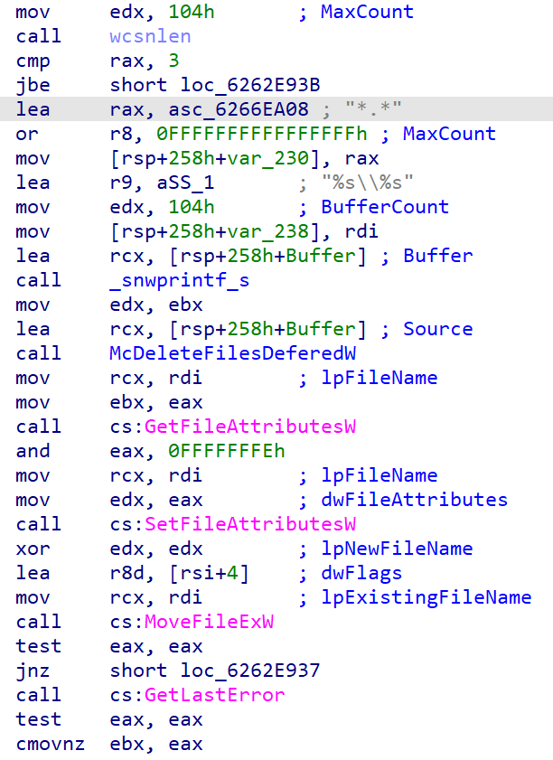
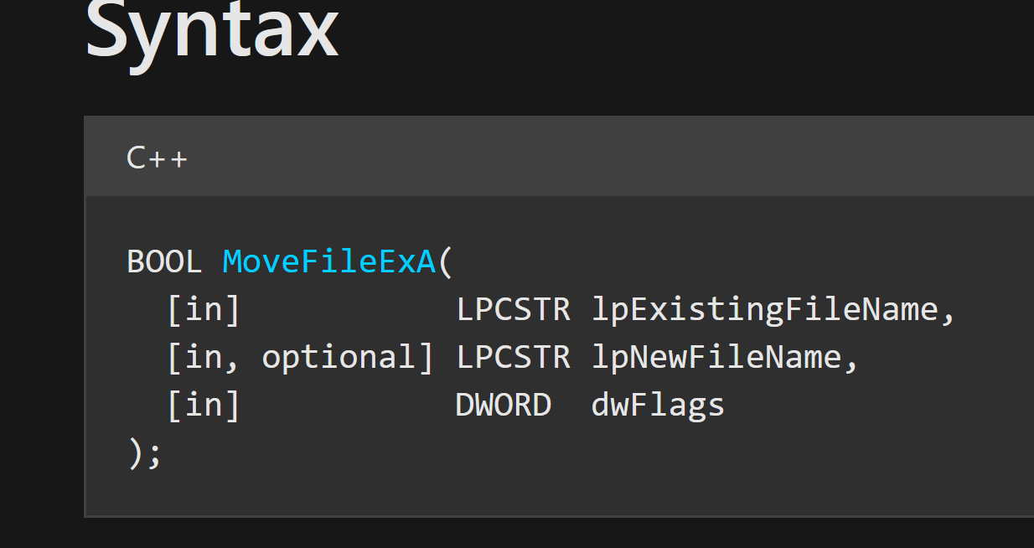
See this function?
So it calls MoveFileEx, and the function says ‘Defer delete’. The disassembler says “lea r8d, [rsi+4]” for the dwFlags argument. How much you want to bet rsi is equal to 0 and that the flag is just 0x4? After all, looking at the docs for MoveFileEx, a dwFlags value 0x4 is MOVEFILE_DELAY_UNTIL_REBOOT. This would work best with deleting those lousy in use files. Defer until later.

Slide 50
So far, we’ve been lucky enough to get away with just the decompiler. However, it’s one thing to decompile, but another to reverse. It requires debuggery and a decompiler. The difference between static analysis and dynamic analysis.
I know, debuggers suck, but it’s the only way.
I prefer x64dbg over the others. Olly is dead, Immunitydbg is too. Ida’s debugger sucks, so does gdb and Windbg, leaving one to reign supreme.

Slide 51
Before we can go about properly reversing, we need a way to load the appropriate DLL, initialize export, then call our entry. We don’t know the exact arguments the exports take, but we know the data types (complements of IDA). I have here a skeleton program I wrote in C, compatible with 64 bit. Just edit the lib name, function name, drop in the debugger and go!

Slide 52
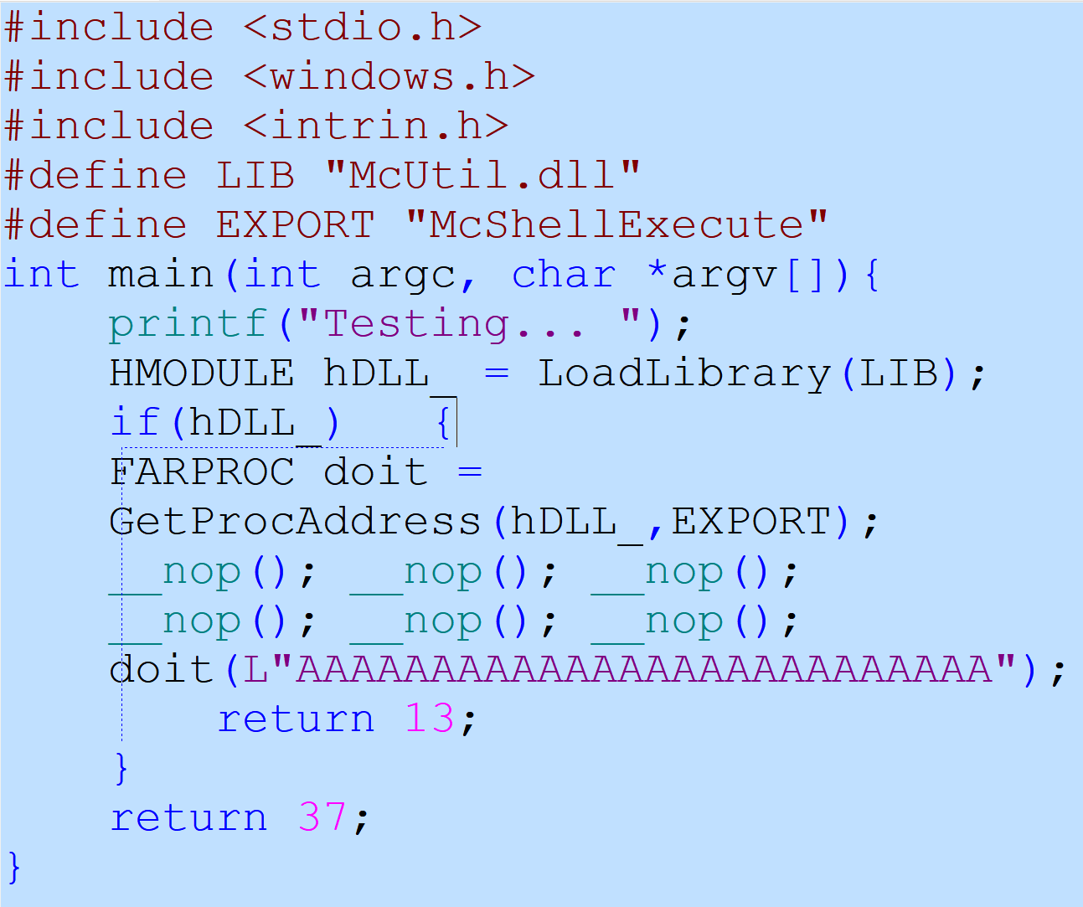

Slide 53
Debuggery / Reversing
Ideally, we have a program that calls the function we’re interested in. In that case, we need only set a breakpoint on that function and single step INTO the function.
If not, then we need a loader. My skeleton loader will get us close by pre-placing a nop sled prior to the export function call. This is where we follow along what is going on. We can see the contents of the stack and registers, step slowly and see what’s being done. Of course you could also just set a breakpoint on GetProcAddress(), but whatever.
The absolute hardest part of reversing a DLL isn’t finding the part to reverse, or implementing the function call, it’s passing the right data to it.
You could have some function that looks like it takes an unsigned integer as an argument to say RAX, but then you load something in and call it crashes hard. This could be Ghidras fault, or the programmer’s.

Slide 54
McShellExecute from McUtil.dll / McAfee

Slide 55
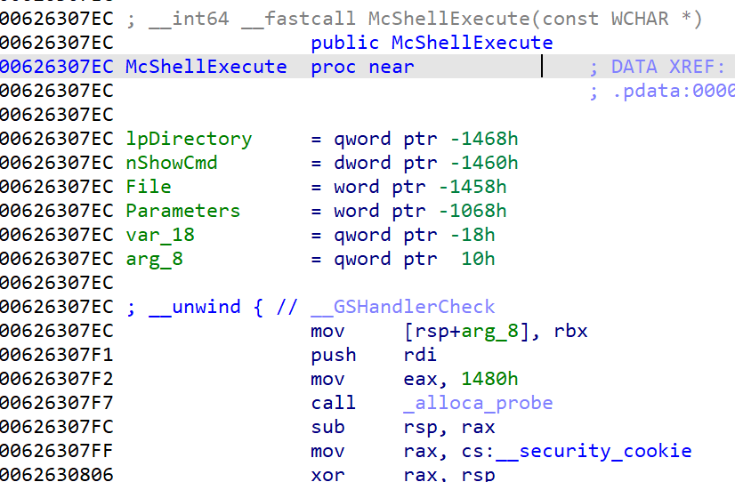
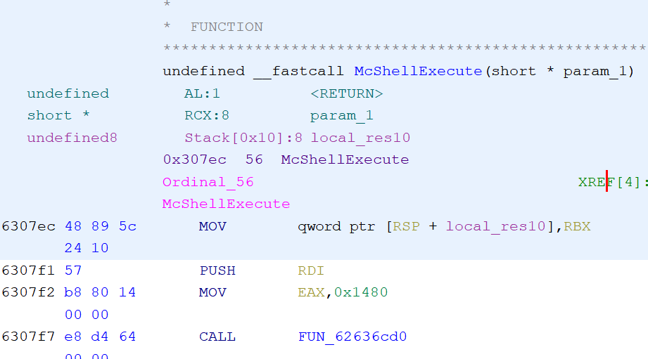
First, we load our DLL export into our disassembler. Sometimes IDA is better than Ghidra. The params were guessed better in IDA. A short type vs a wide char array for execution???

Slide 56
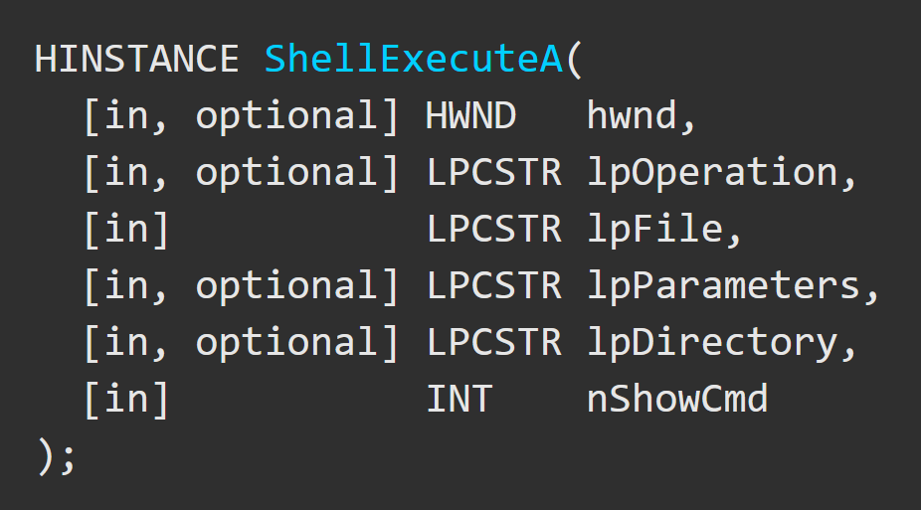
Its not ShellExecute, its McAfee ShellExecute!
Given this, we might as well look up the arguments. Since McAfee’s function only takes 1 argument, the question is where does it go? To the debugger!

Slide 57
Here we have our NOP sled, or wide string argument “aaaaaaa”, and the call into our DLL function.

Slide 58
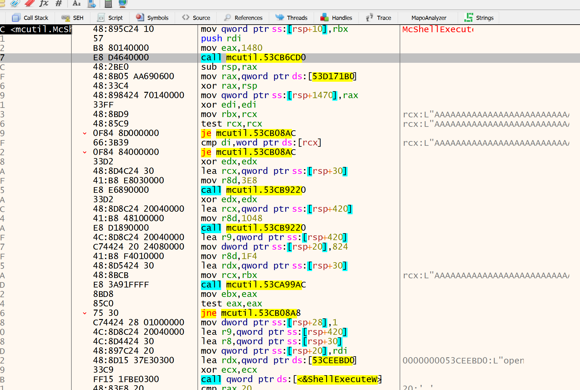
At the bottom, there’s our ShellExecuteW call. We can see one of the arguments loaded into RDX as ‘open’. Referring to our API doc, this means open a file or folder. The first few calls are just memset calls, moving our variables around. The second to the last call though, that’s more interesting.

Slide 59
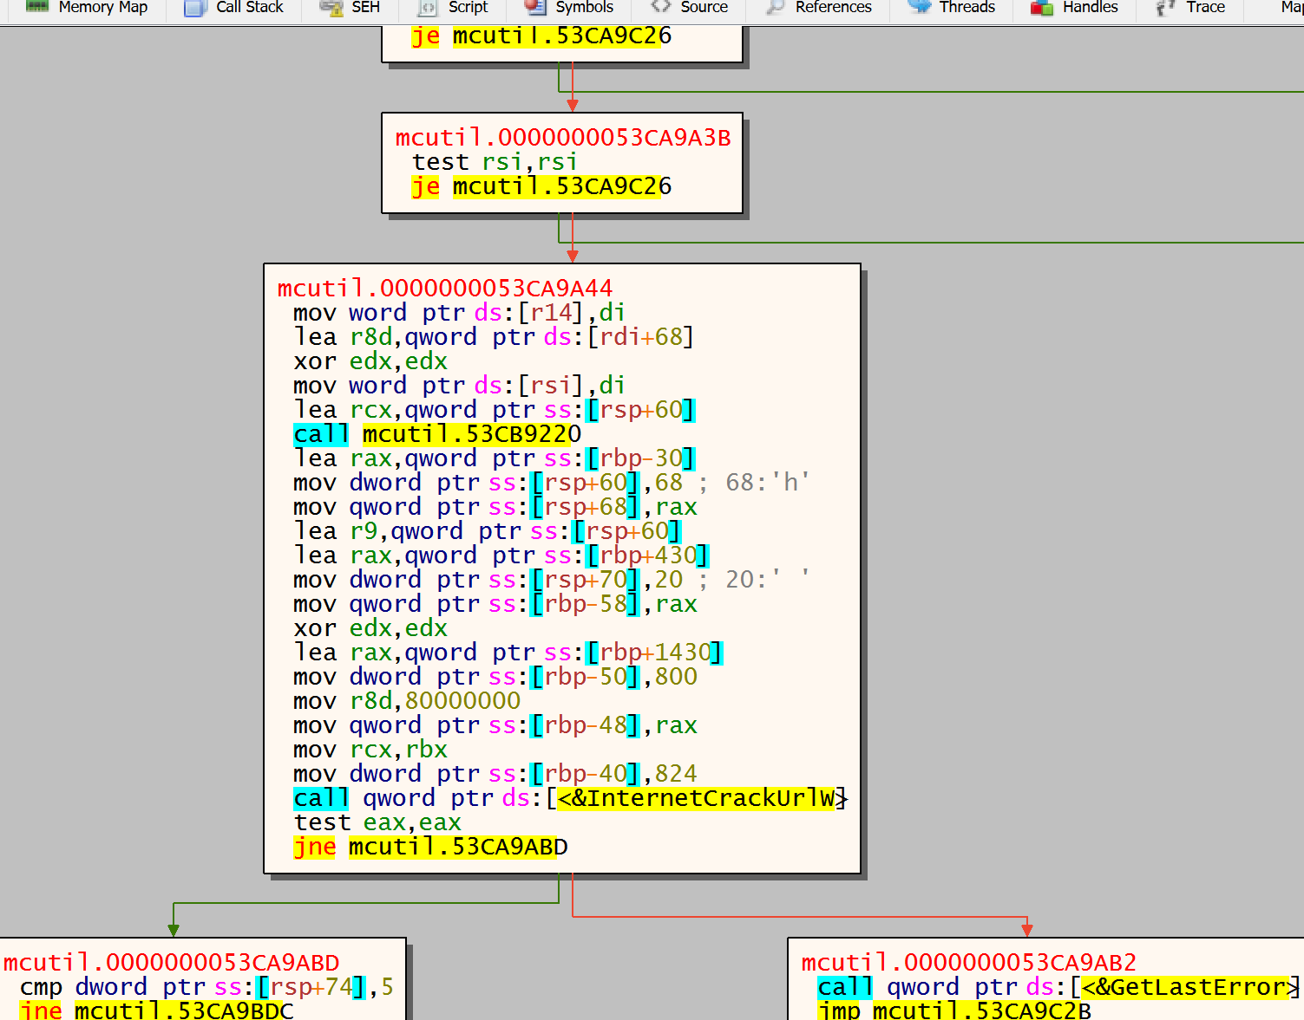
InternetCrackUrlW huh? Well that can only mean one thing – my “AAAAAAAAA” argument wont work. This function is used for dividing up URL parameters.
What does this mean? It means our ShellExecute function is using the ‘Open’ parameter, but is expecting a URL.
Let’s change our ‘AAAAAAA’ argument to a URL and see what happens.

Slide 61
Finally, DownloadFile() from EzULIB.dll / Asus

Slide 62
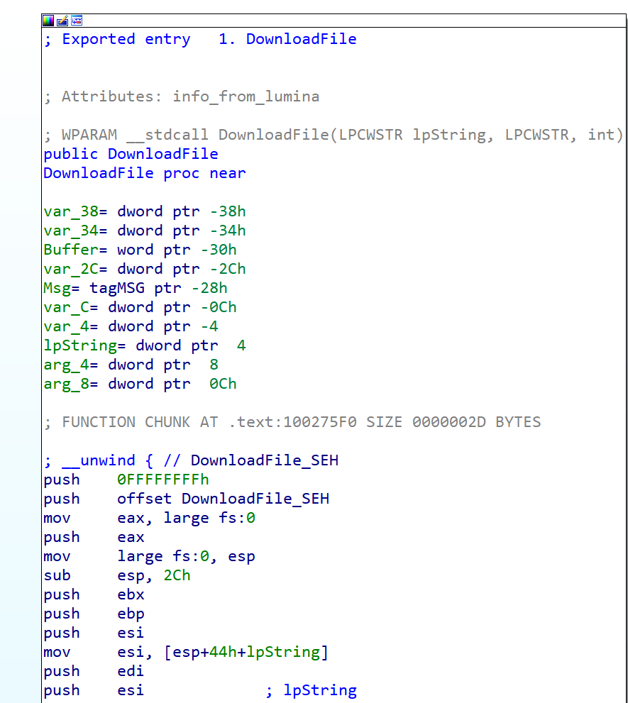
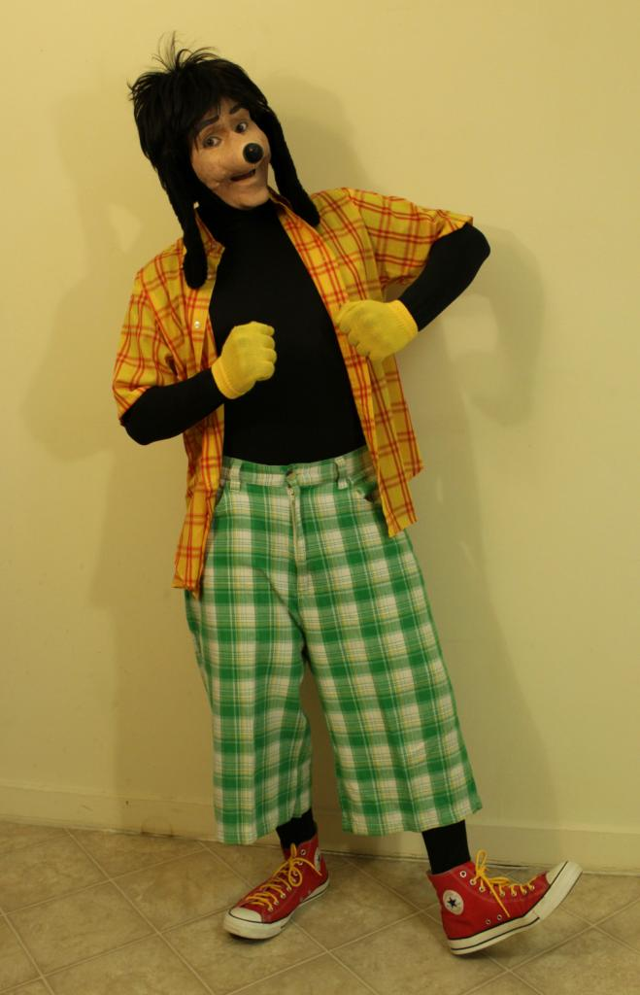
Into the disassembler we go.
3 arguments. 2 wide strings, 1 integer. With the name DownloadFile, once can assume this will utilize some form of winsock or wininet function.

Slide 63
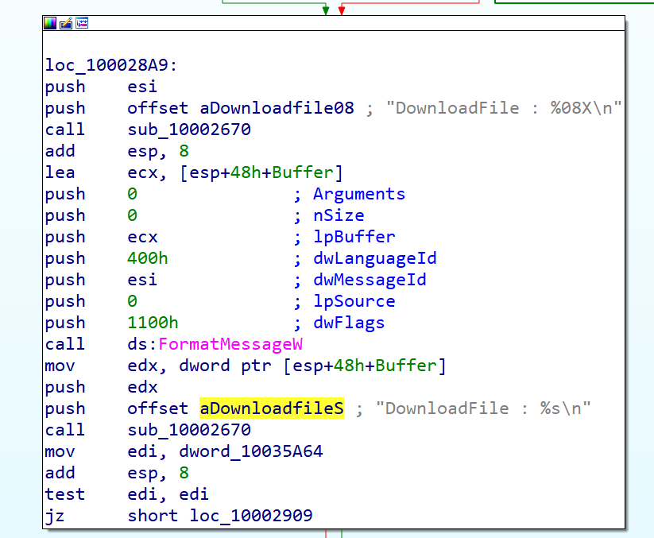
FormatMessageW?
calling cards of a Windows GUI app. Likely showing on some window what’s being downloaded.

Slide 64
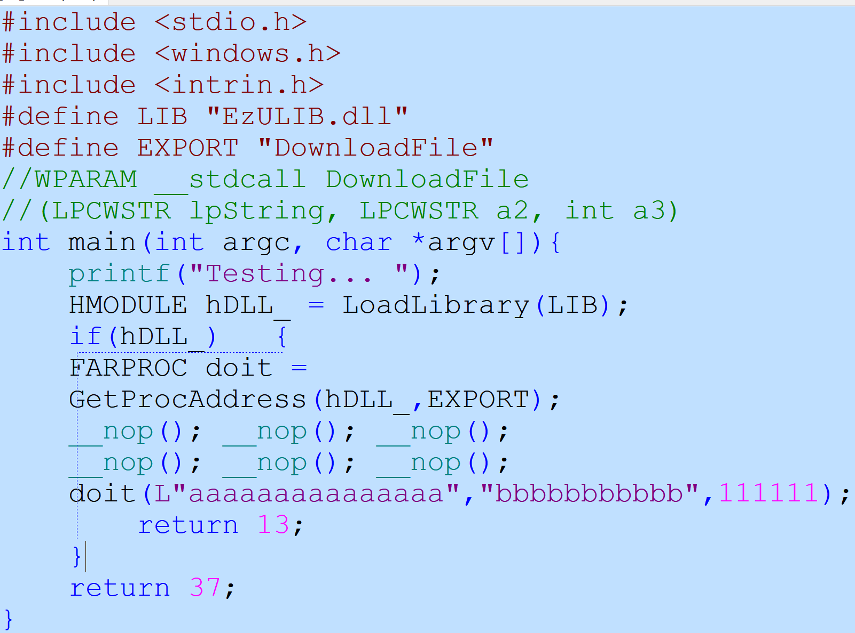
First, we modify our skeleton program, add some args, then we launch. Don’t forget to switch from 64 bit to 32 bit when compiling.

Slide 65
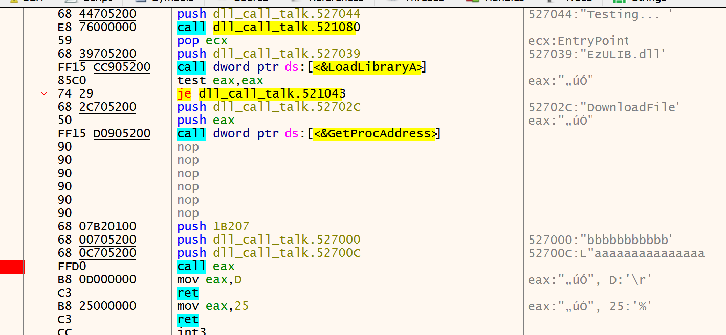
Into our debugger, proper args, step into DLL land.

Slide 66
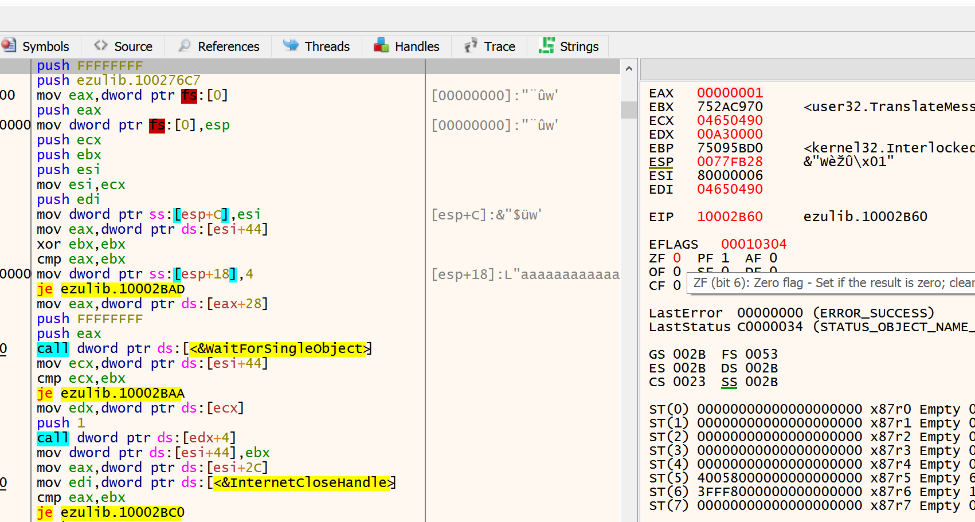
While single stepping this thing, it becomes quickly apparent that this function is complex. Lots of twists and turns. Lots of sub routines, calls, etc.
We see threading is being employed via the WaitForSingleObject call and we see Internet functions being called as well. We have 2 options. 1 is go backwards from the APIs we see, or 2 go, go forward. If threading is involved, then a CreateThread call will be present that will have a sub routine attached that might be what we’re looking for.

Slide 67
IDA sees a reference to _beginthreadex, but that function has no external references to it. Damn, dead end.

Slide 68
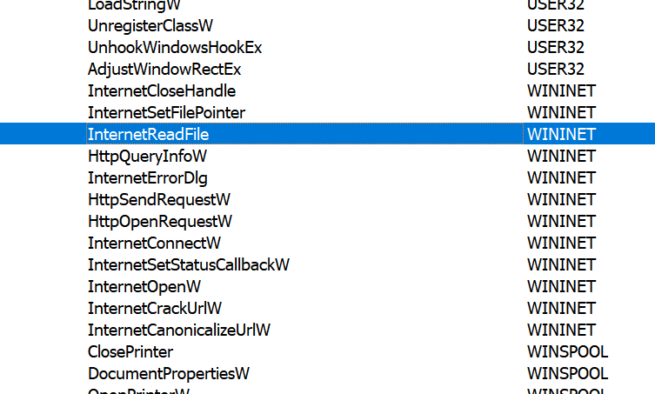
Running through this thing going forward isn’t working. Let’s try and go in reverse (no pun intended). We see an import for InternetReadFile

Slide 69
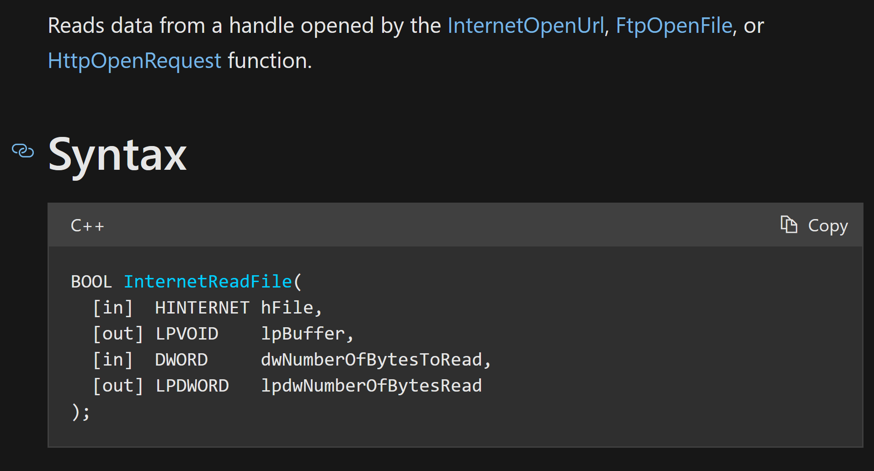
This is the perfect function as it aligns best with downloading a file.

Slide 70
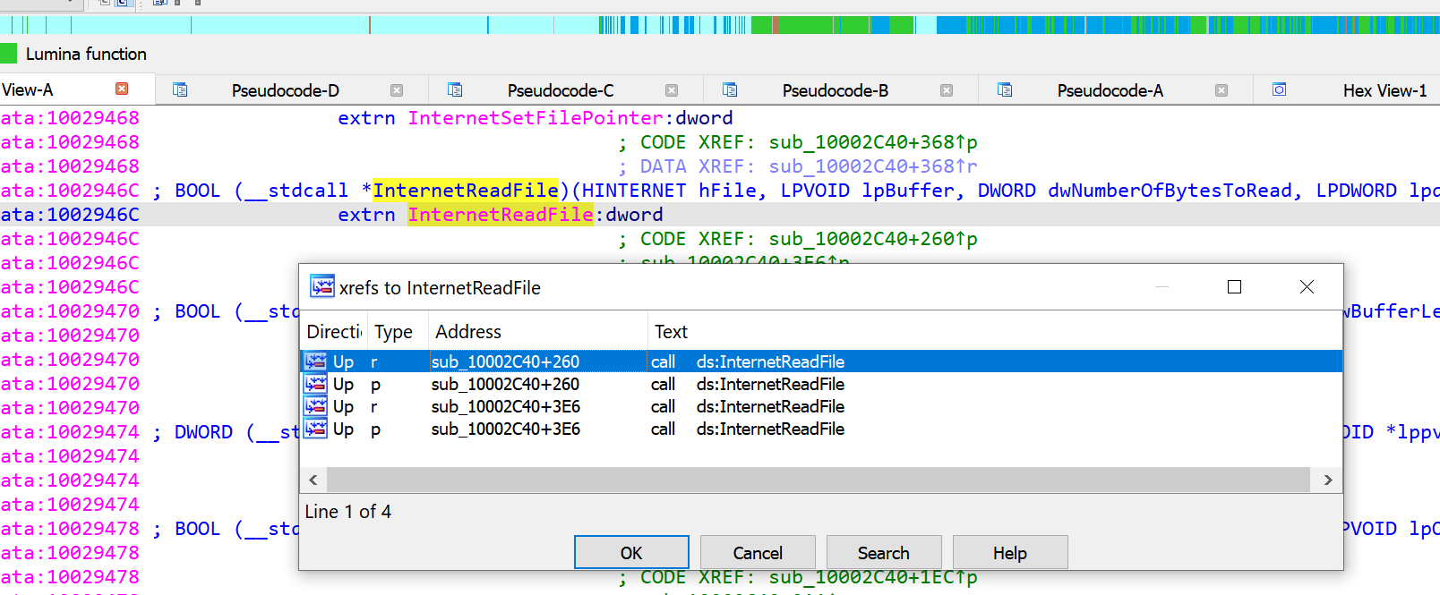
IDA shows our external references to a sub routine at 0x10002C40.

Slide 71
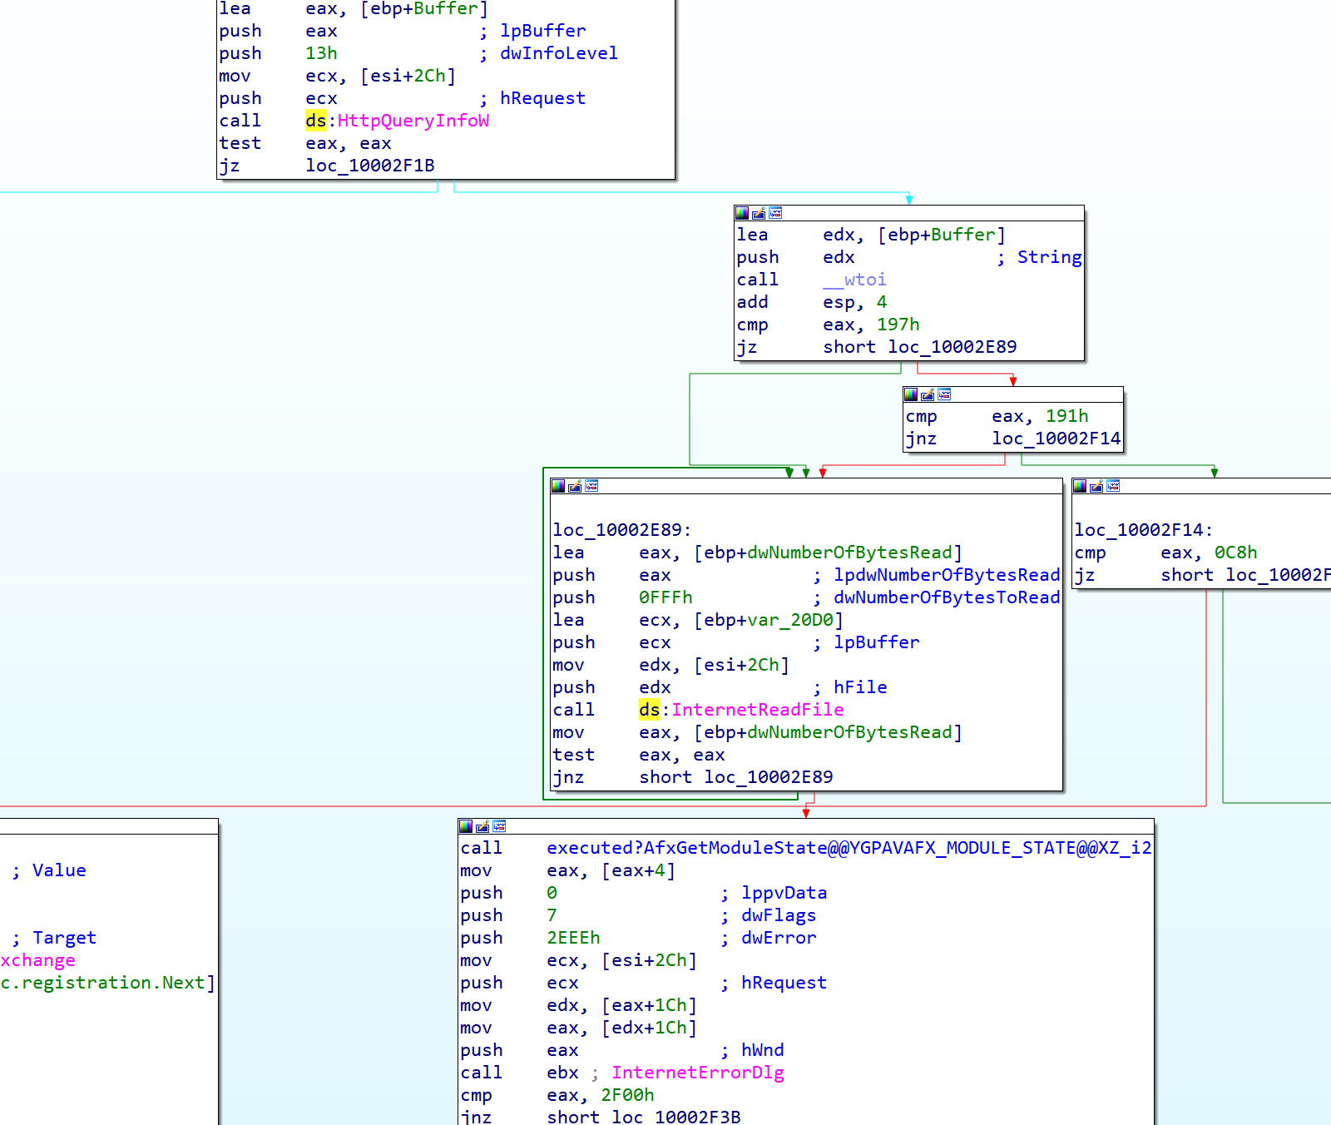
That’s more like it. Download code. HTTP requests. Let’s trace backwards from here.

Slide 72
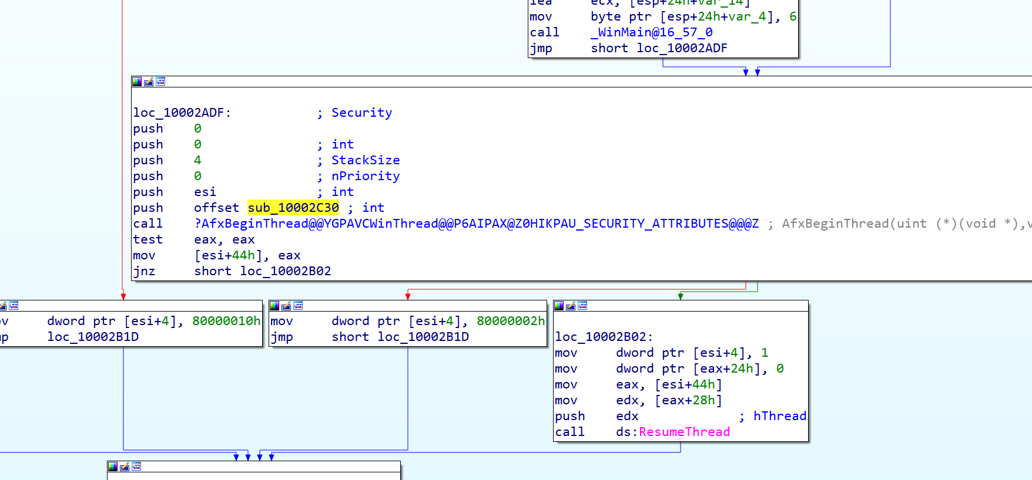
I was right. Threading, but not your traditional Win32 API. Actually an MFC intrinsic that does the same thing.

Slide 73
External reference to here, brings us right to the original export. Great. So a new thread is created that takes a URL string, a pointer, and a character. The URL string being one of our arguments pushed to the stack before the call. We should modify our arguments to URL’s.

Slide 74
So InternetReadFile gets a handle from InternetOpenUrl, or HTTPOpenRequest. I didn’t see InternetOpenUrl, but I saw the other one. Setting breakpoints, we can see the first argument is the URL. The second argument is the destination folder. The third argument does….?
We also can’t seem to control the file name. Its hard to follow the second argument through all this garbage.
What’s interesting is the call to
dword ptr ds:[edx+0x38]
What’s inside?

Slide 75
WriteFile call. Can’t seem to find out file name. Seems to have something to do with our second arg.
On a whim, running the second argument with ‘./’ to denote the current directory for presumptively a save destination yields some fruit. Weird names, but file names none the less. And data in them apparently.

Slide 76
Sure enough, JPG file.

Slide 77
Did it work? Hell yeah! File name the function saves with is wrong, but we can rename. We were able to successfully download a file using someone else’s undocumented code.

Slide 79
Now we know and knowing is half the battle.

Slide 80
Any questions? If not, thank you for listening!

