Slide 1
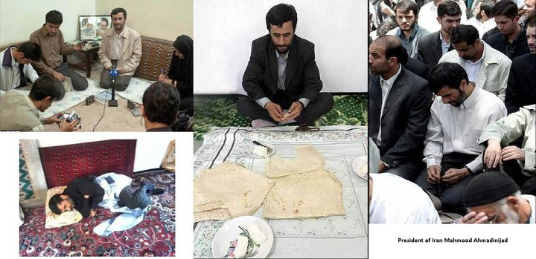
The FinFisher Malware Suite
A quick breakdown by Joe Giron

Slide 2
The hell is FinFisher?
FinFisher suite of malware tools that belongs to a UK company known as Gamma International (formerly GammaGroup). The company produces spyware, exploits, and a slue of other intelligence gathering tools. Their clientele include intelligence agencies, law enforcement, government entities, and foreign regimes.
Today we will be looking at FinSpy – the remote windows spying component.

Slide 3
Capabilities
Certificate based encryption
Remote File Access
Key-logging
Password Sniffing
Webcam Recording
Microphone Recording
Local Passwords Theft
E-Mail Dumping
Chat Logging (MSN, ICQ, IRC and Skype)
Geo-Location
Generic system information collection
Remote Command Shell Capabilities

Slide 4
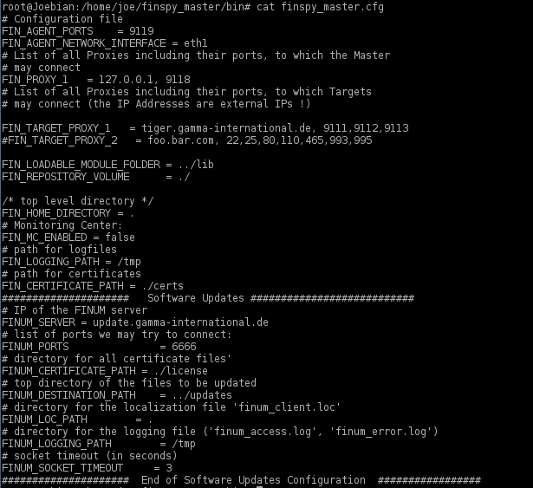
FinFisher Master Server
Fairly simple config. Set the proxy server for listening, set the ports, certs, etc.
The master server comes with a few windows exes (next slide) for attaching a target jpeg, mp3, word doc, or whatever to your exe.
Notes:
The code behind the server is interesting, but is best saved for a blog post or another talk.

Slide 5
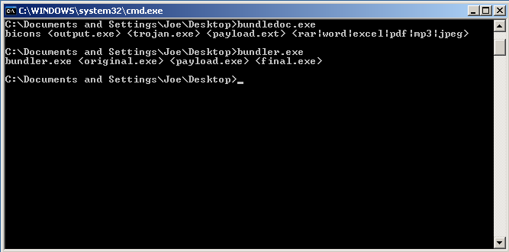
FinFisher Master Server p2
The server when installed has a ‘TargetModules’ directory that contains a few executables. The ‘buildx.exe’ file is a hollow skeleton of the binary I’m about go over (FinSpy). ‘bundledoc.exe’ will bind a document file (word, spreadsheet, pdf, image, mp3, etc) to the trojan so that when the trojan is run, this file is launched afterwards to lower suspicions. The resources sections of all 3 binaries contain the decrypted loaders and rootkit, but that’s kind of cheating.

Slide 6
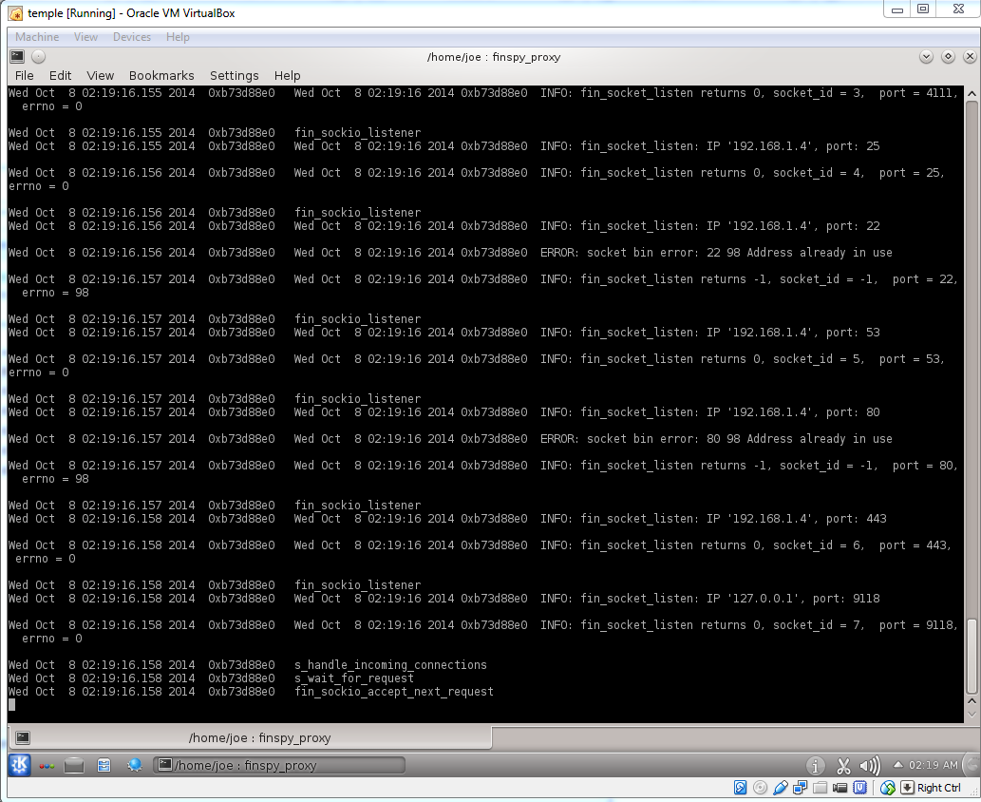
FinFisher Proxy
The FinFisher Proxy server accepts SSL connections from ports 22, 25, 53, 80, 443, and 4111.
It communicates with the master server over port 9118.
I guess that’s one IOC to watch for – HTTPS traffic on ports other than 80/443.
The config is pretty simple too – set ports, set log file, set networking device. That’s it!
Notes:
Debian 32 bit. My version was 2.10 (finproxy).

Slide 7
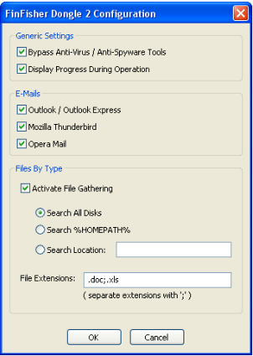
How does it infect?
Email communications. The files have jpeg icons to fool users. They are sent as attachments. Given the picture of Iran’s president, I’m inclined to believe the intended audience is politically motivated. They probably make use of the Right-To-Left character (unicode 202E) to shift the extension to the left. On a unicode enabled client, it would make the file show up as ‘exe.NotAVirus.jpg’.
Thumb Drives / dongles. The SpyFiles documentation gathered on Gamma International show a tool called ‘FinFly’ which makes use of dongles for plug and play exploitation assuming physical access is possible.

Slide 8
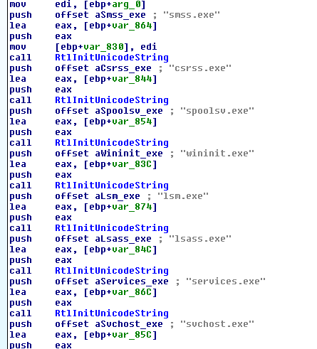
How does it communicate?
SSL encrypted streams. After rootkit infection, the malware spawns a legit system process, hollows it out and injects a dll into it which then communicates with the FinProxy server which in turn sends its data to the master server.

Slide 9
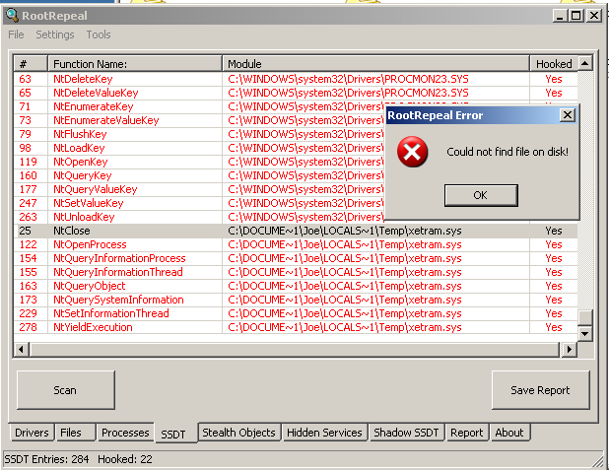
What happens after launch?
It loads that picture you saw at in the first slide. It then loads a rootkit and chills secretly stealing your data. Among other things, it hooks the System Service Dispatcher Table and hides itself from traditional dumping.
Notes:
GMER isnt as cool as RootRepeal.

Slide 10
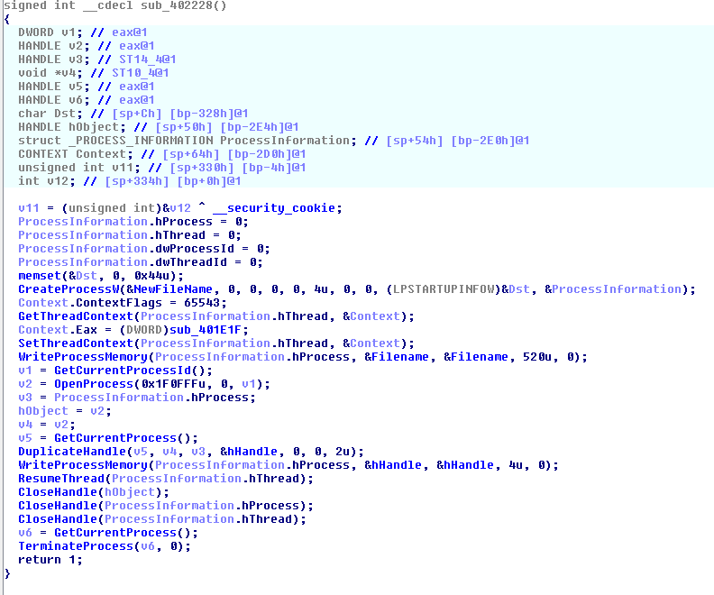
Details pls!
FinSpy uses process hollowing as a means to inject itself another processes to run its code. This is where you spawn a legit process like say…svchost.exe suspended, allocate some space, write your evil code inside with WriteProcessMemory(), duplicate any handles you had before, get the original program’s main thread context, then set the main thread’s context of the newly spawned process and BAM – now it appears as though svchost.exe is doing the evil deed instead of the original binary.
In FinSpy’s case, it copies itself into the temp folder, then performs this process hollowing technique against its own copy and runs that copy before exiting.

Slide 11
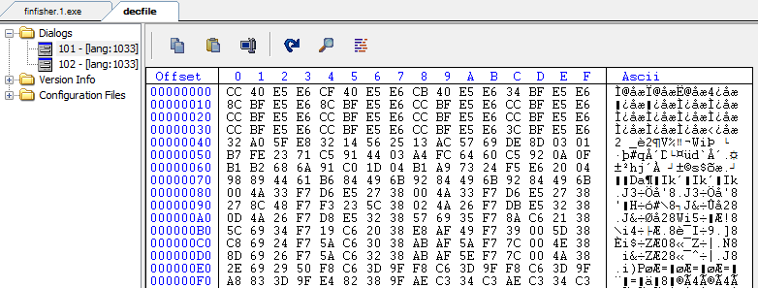
Moar Details pls!
After running itself from the temp folder, the malware decrypts its modules stored in its resources sections(more on that next). The resource when decrypted contains the second dropper which is responsible for dropping the rootkit and also includes anti-sandboxing code. The rootkit is also stored in the resources section as a dialog.
Hope I didn’t lose you there. Here’s a crude representation:
[exe<.rsrc>]→ [exe<.rsrc>]→ [rootkit]
Notes:
101 was rootkit, 102 is the user hooker dll

Slide 12
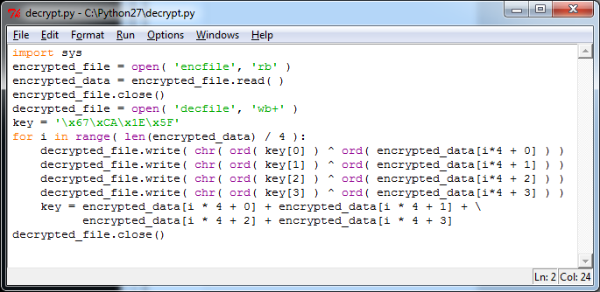
Encryption / Decryption Oh My!
Every module used by FinSpy is stored in the resources section and encrypted by a 4 byte key. That key is 5F 1E CA 67. Extraction is easy with Python:

Slide 13
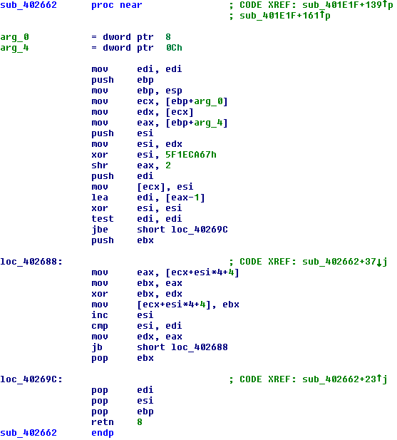
Same Xor Key? REALLY???
I have proof that the one leaked in 2012 is similar to the one dropped in September. The file md5 is different, but the XOR key for decryption of the dropper module is the same.
According to https://citizenlab.org/2012/07/from-bahrain-with-love-finfishers-spy-kit-exposed/ the XOR key used for decryption of modules is the same. This makes sense since the brochure said every exe is changed to avoid AV detection, but apparently not changed very much.

Slide 14
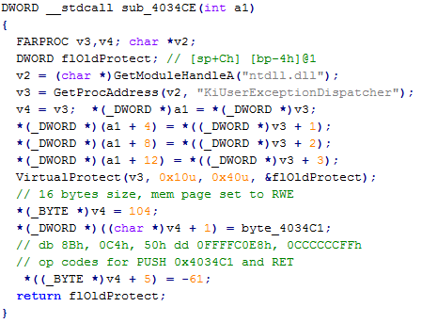
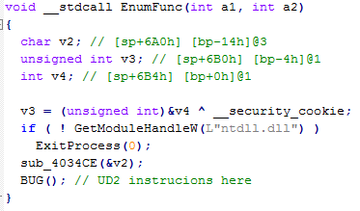
Am In in A sandbox?
FinSpy includes sandbox detection via Structed Exception Handling. It writes a few bytes (call to the rootkit dropper) into the function KiUserExceptionDispatcher, then triggers an exception using the opcode ‘ud2’. When an SEH kicks in windows calls the bytes replaces in the exception dispatcher function. It does this 3 times. The idea is that a sandbox will just see the app crashed several times and give up.
FYI, putting the ASM for this in PP sucks. It wont fit. Take my word for it. And the HexRays code is even worse:
Notes:
You’ll have to trust me on the code. Or take it up with me after the talk ☺

Slide 15
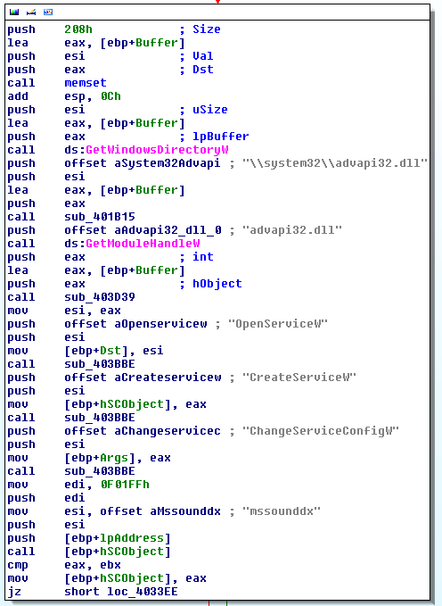
Rewt Kit
After decryption, sandbox checks, and generally making my reversing life miserable, FinSpy drops a rootkit. The rootkit modifies your MBR (BAD) to hook INT13 calls. INT13 is responsible for disk reads. This allows the malware “procmon” functionality by going as low as possible. AV’s don’t go this low. Every time a disk read is performed, it spawns a new thread for logging and acquisition.
You wont be able to see it on disk as its memory resident, however before it goes memory resident you WILL see a new service created with the name ‘mssoundx’ with the driver named ‘driverw.sys’ In fact, it’s a real pain to detect period. The one thing that stands out though is how the rootkit initializes data logging – it spawns a system process that’s auto-launched after killing. Example – on my win7 64 VM, it kept loading explorer.exe from the syswow64 folder instead of the windows directory and would come back immediately after killing.

Slide 16
Data Theft
It grabs everything it can including keystrokes, geo location, microphone & webcam surveillance, skype monitoring, email logging, and more.
The data is encrypted with 256 bit AES and stored in the same directory as where the rootkit was first stored – the %windir%\Installer folder.
It will send your data to the Finproxy of your choice which then sends back to the FinMaster server for handling.

Slide 17
How do we detect it?
Pre-op - Yara rules
Postmortem – RootRepeal, GMER, presence of files in the installer directory since that’s where it stores its intercepted data.
Don’t trust email
Force the ‘show extensions for known file types’ setting in Windows.

Slide 18
YARA Detection
rule finfisher : lolwut
{
meta:
description = "Joes FinSpy rule“
strings:
$a = {67 CA 1E 5F}
condition:
$a
}

Slide 19
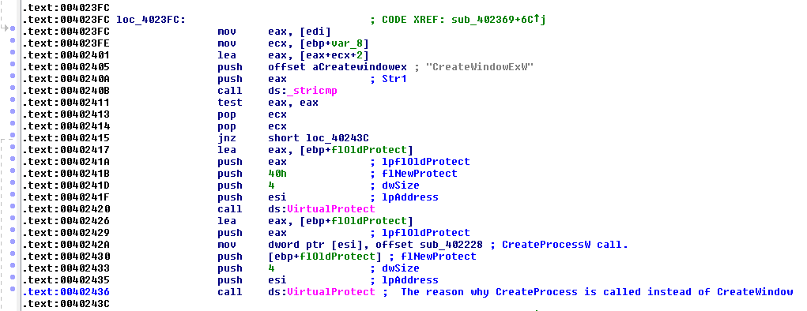
Unique Tricks
This threw me off for about 20 minutes. The app launches when CreateWindowExW is called, but it actually calls CreateProcessW. It does this by re-writing the address of CreateWindowExW with CreateProcessW. So when my debugger sets a breakpoint on CreateProcess, nothing happens. Thank god for IDA.

Slide 20
Final Thoughts
This was some advanced stuff. Unlike traditional malware which mostly falls under the “written while bored on a Sunday” category, there’s money behind it. As a result, its far more advanced than what one typically runs into on the net.
FinSpy isn’t fool proof. You’ll be able to see it with conventional anti-rootkit tools like RootRepeal and GMER. If you have an anti-malware appliance that supports YARA, you can pick it out of the line-up. Those of us without that fancy stuff will have to rely on the usual techniques (not being stupid) to avoid infection.

Slide 21
Works Cited
WikiLeaks produced a document a few years back titled ‘SpyFiles’ https://www.wikileaks.org/the-spyfiles.html
I did a lot of work on this, but codeandsec beat me to it in his analysis https://www.codeandsec.com/FinFisher-Malware-Dropper-Analysis
These 2 gentlemen beat us both with their analysis of the exe in 2012 https://finfcuker.wordpress.com/2012/08/
https://citizenlab.org/2012/07/from-bahrain-with-love-finfishers-spy-kit-exposed/

Slide 22
Questions?

