Slide 1
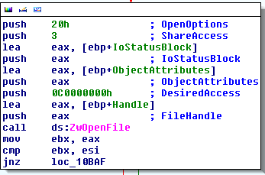
Reverse Engineering Malware For Newbies
A guide for those of you who want to break into the fun world of malware.

Slide 2
What We’re Going To Cover
Basic x86/64 ASM
Tools of the trade
Setting up an environment
Intro to the Debugger
Basic Debugger Usage
Reporting
Basic Malware Analysis
Unpacking 101
Dynamic Analysis
Memory Analysis
Where to get malware
Help! I’m Stuck!
Additional Resources

Slide 3
Basic X86 / 64 ASM
My good friend Eric Davisson will now speak about the basics of X86 assembly.

Slide 4
Tools of The Trade
Every reverse engineer should have these in their bag:
Debugger - ollydbg, windbg, syser, IDA, immunity.
Disassembler – IDA, olly, immunity, windbg
System Monitoring tools - procmon, Process hacker
Misc tools - exeinfo, HookAnalyser, Cuckoo Sanbox, gmer, rootrepeal, wireshark, volatility, HXD, ilspy, jd-gui, p32dasm, cff explorer, winprefetch viewer, autoruns.
Lot's of tools, but they each serve a purpose. Over time you'll become accustomed to each one and wonder what you ever did without them.

Slide 5
Setting Up Your Environment
Every Environment should be off your network unless absolutely necessary.
Use a VM!!!
Sandboxie is no substitute
Cuckoo works wonders
Dual monitors are a godsend

Slide 6
Enter The Debugger
The debugger is your best friend. Treat him with respect.
There are 2 kinds of debuggers - kernel debuggers and usermode debuggers.
A kernel debugger operates at ring 0 - essentially the driver level and has direct access to the kernel.
A usermode debugger is the opposite, having only access to the usermode space of the operating system. Most of the time, this is enough, but not always. In the case of rootkits, or even super advanced protection schemes, its preferable to step into a kernel mode debugger instead as user mode would then become untrustworthy.

Slide 7
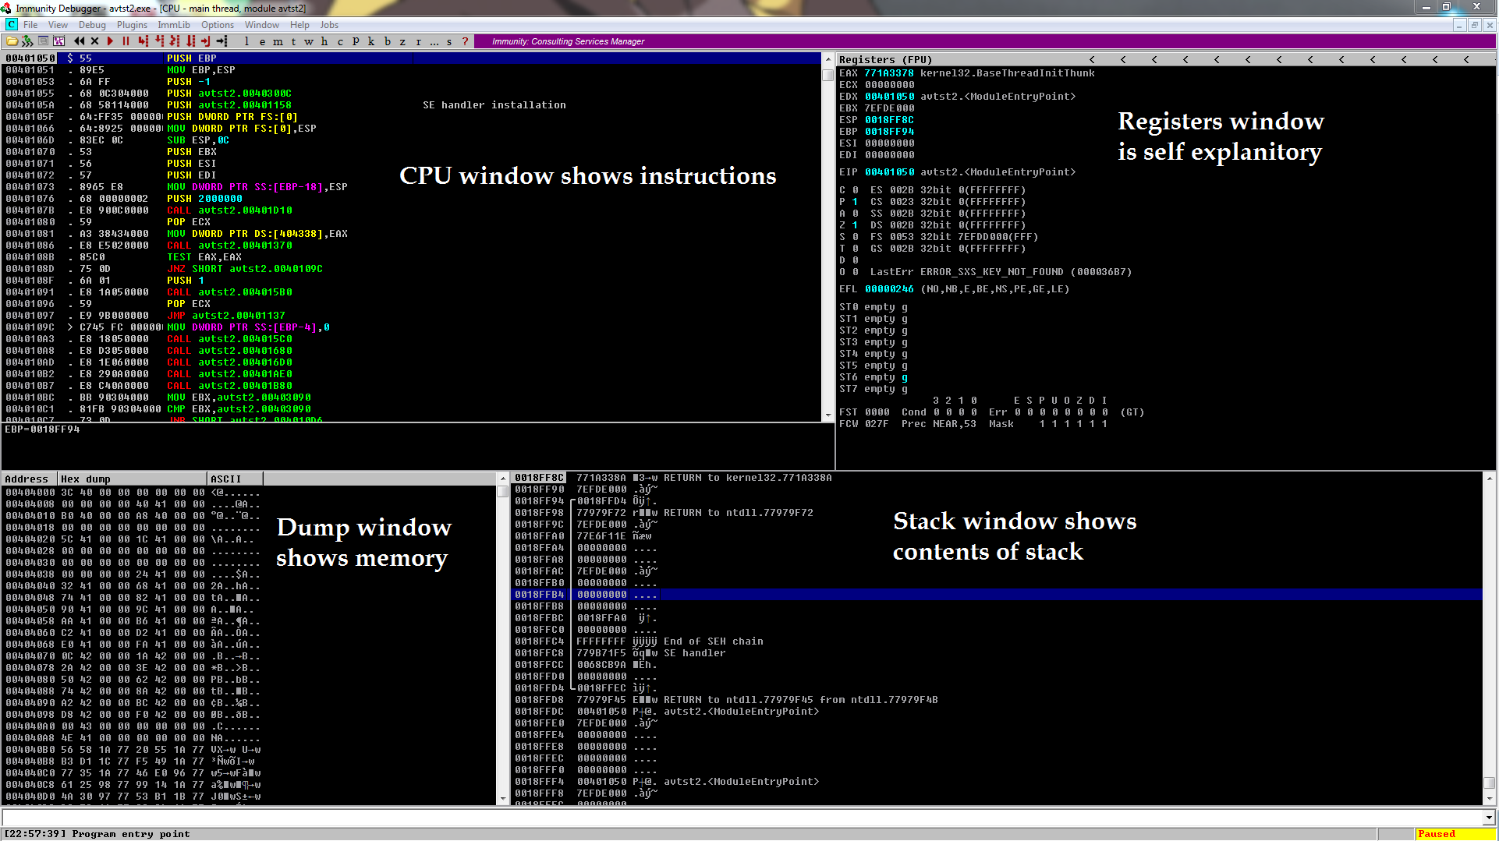
Immunity Break Down

Slide 8
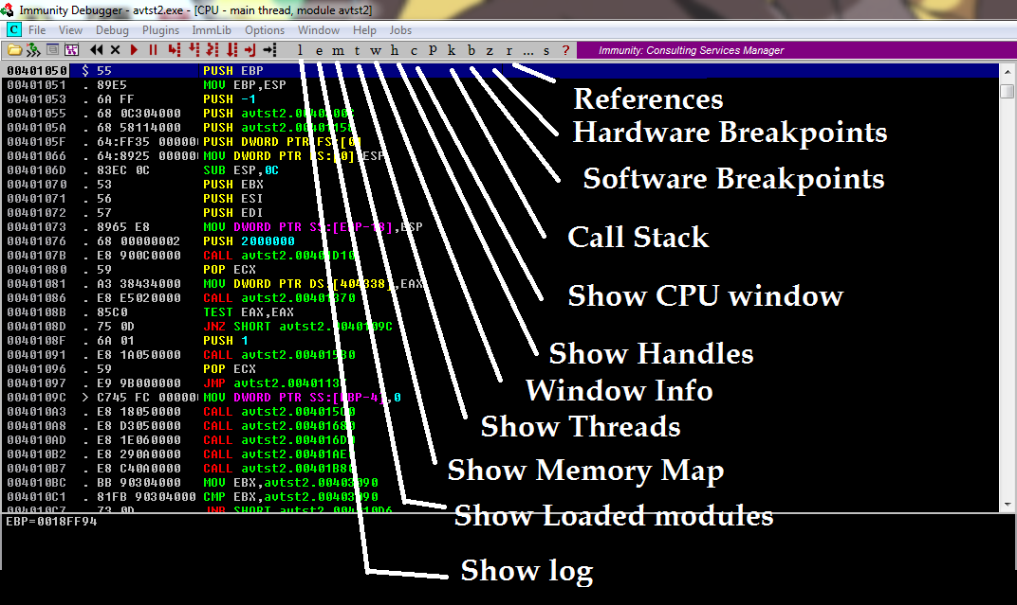
Immunity Breakdown 2

Slide 9
Software Breakpoints
Software breakpoint are CPU interrupts that can be placed anywhere in a program.
When you set a software breakpoint, the debugger simply writes the int3 instruction (opcode 0xCC) over the first byte of the target instruction. This causes an interrupt 3 to be fired whenever execution is transferred to the address you set a breakpoint on. When this happens, the debugger takes control and swaps the 0xCC opcode byte with the original first byte of the instruction so you can continue execution without hitting the same breakpoint.
If the program is not running inside a debugger, the operating system will execute default handler structured execption handler to terminate the program.

Slide 10
Hardware Breakpoints
Hardware breakpoints are different from their software counterparts. They use the int1 instruction and are used for single stepping in conjunction with debug registers. There are 8 total, but only the first 4 are used. DR0-3. Sometimes it is preferable to use hardware breakpoints when normal software breakpoints fail such as when a program computes a checksum.
Software breakpoints are inserted into a program (albeit briefly) and thus, change the program. Hardware breakpoints however are not and rely on those 4 debug registers. This means however you are limited to 4 breakpoints which kind of sucks.

Slide 11
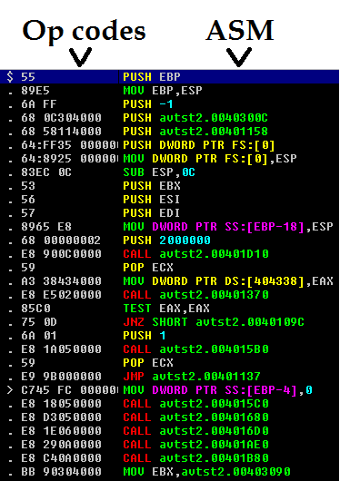
Opcodes
Opcodes are the hexadecimal representation of assembly instructions.
The stuff you'll see if you were to view the executable in a hex editor. YARA rules match opcodes.

Slide 12
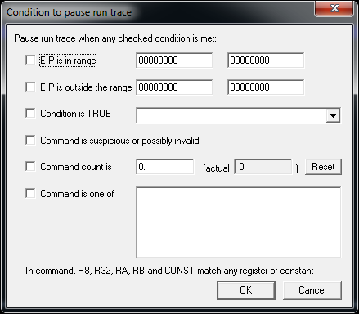
Tracing
A run trace is an excellent debugging technique that allows a reverse engineer to “trace” execution flow based on certain parameters. Rather than going sequentially through a program, one can define a base line, and track backwards the flow of execution by tracing where and how a program will run.

Slide 13
I HAVE THE POWER!!!
With a debugger you have total control over the program and you should never forget that. If you see a function that looks juicy in IDA, but see no plausible way to get there via xrefs, nothing is stopping you from jumping to it. Just modify the program's prolog to jmp 0xwherever. This works well especially if the function takes no arguments, otherwise except funky output or an app crash.

Slide 14
Jump2self
One of those old school tricks any assembly guru will tell you where which you jump 2 bytes forward and the jump itself is 2 bytes. Jump to yourself. An infinite loop. In x86 asm, the opcodes are 0xEB 0xFE.
From time to time I use this trick, for example when a new process is created of the same program and I want to continue execution before the app is run.

Slide 15
Basic Debugger Usage
Load up the program ‘debuggertest1.exe’ from your ‘Samples’ folder.

Slide 16
Patching
Patching is the process of adding or removing assembly instructions in an exe without source code. It could be something as simple as changing conditional jmp to always return true/false, or it could be something complex such as hollowing out a piece of memory and injecting entire functions within and calling them.
Patching can be done with a hex editor, a debugger, or even via the WriteProcessMemory API which is how most video game trainers do it.

Slide 17
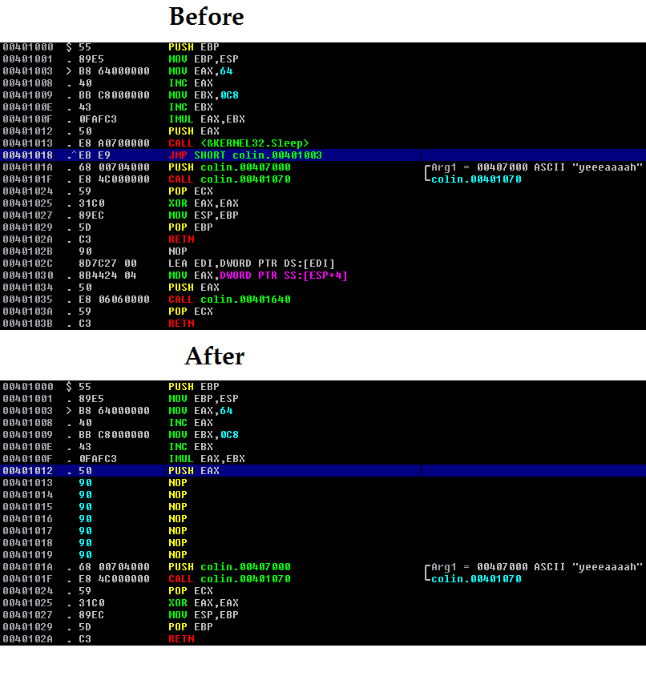
Patching P2
Immunity Debugger has all
of the necessary capabilities
to perform on the fly patching.
Simply right click and choose
‘assemble’. Immunity will also
auto-correct for alignment.
Saving your patches is as easy as right clicking and choosing the option 'copy to executable', then selecting the sub option 'all modifications'.

Slide 18
Basic Malware Analysis
Here we go over a very basic sample <order_report_id_34872384972398472398.exe>
It will be in the folder named ‘samples’ on the drives I handed out. Open it up in your debugger / VM and we’ll go over it together.

Slide 19
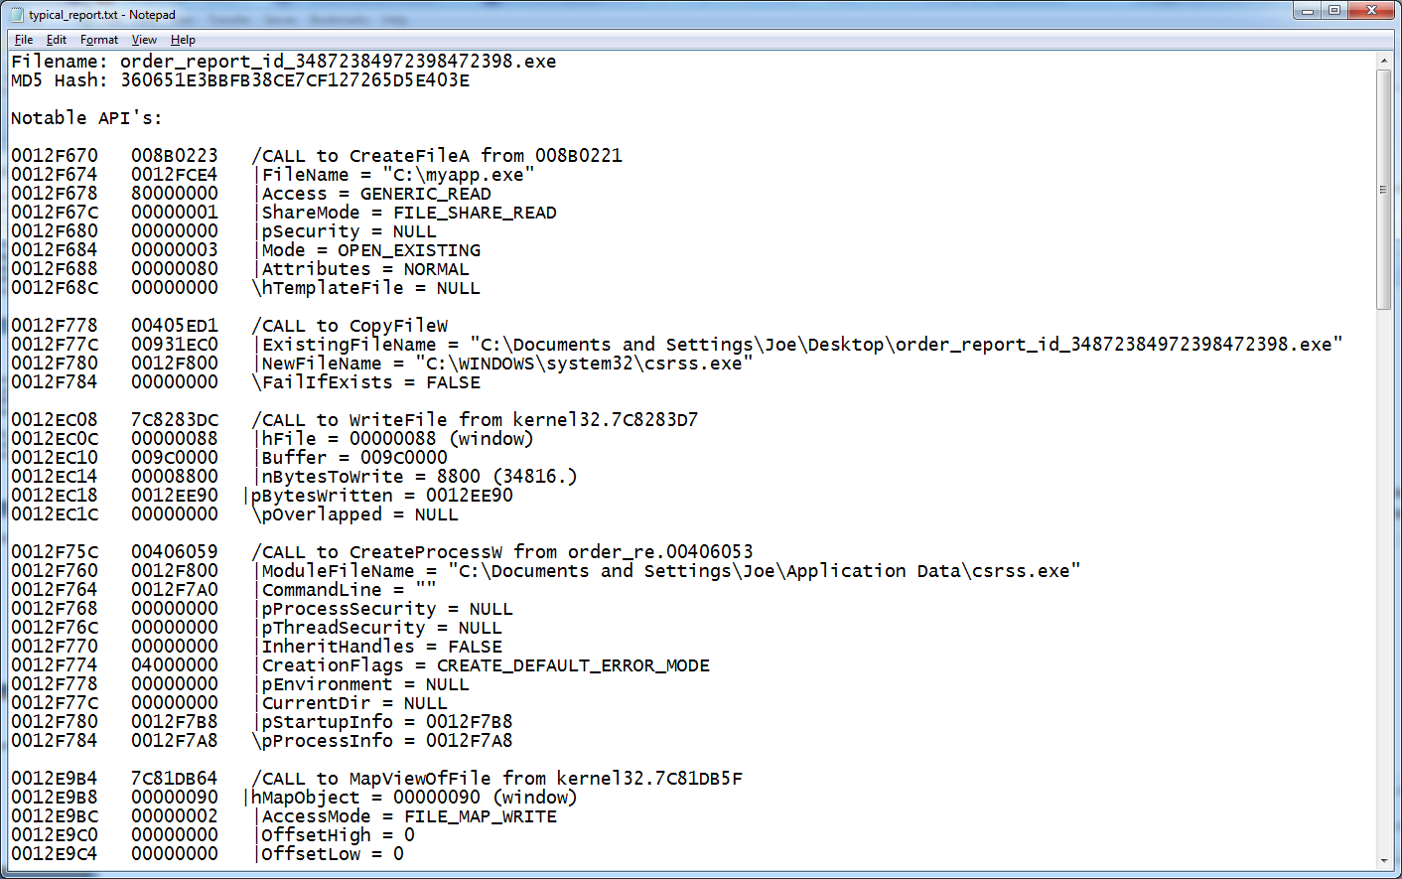
Reporting
There is no “typical” reporting structure when it comes to classifying / documenting malware, however I like to keep my reports with the most essential fields such as the MD5, API’s, C&C IP’s, and IOC’s
Its good to keep reports descriptive, but do not go overboard.
Example of one of my reports: http://gironsec.com/typical_report.txt

Slide 20
Unpacking 101
Most malware today is packed in some way to help get around AV signature detection
There are over 8000 known packers out there, each with their own signatures.
They can range from simple compression to full on encryption / debugger detection and generally make the life of the Malware Reverser a pain.
Packers are not fool proof – the exe HAS to be decrypted / decompressed at SOME point in order to run on the OS.

Slide 21
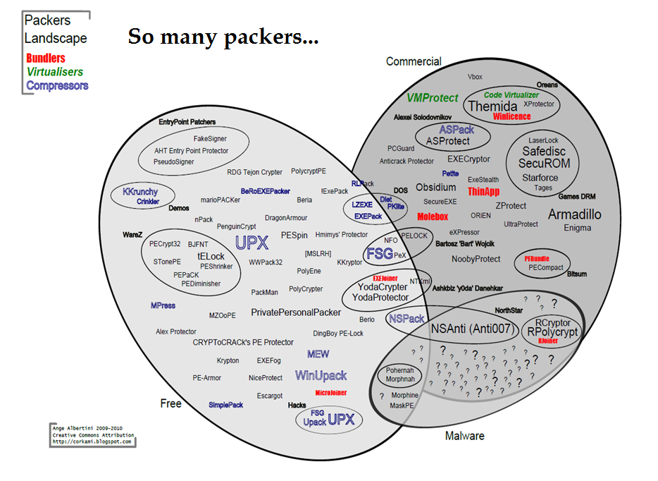

Slide 22
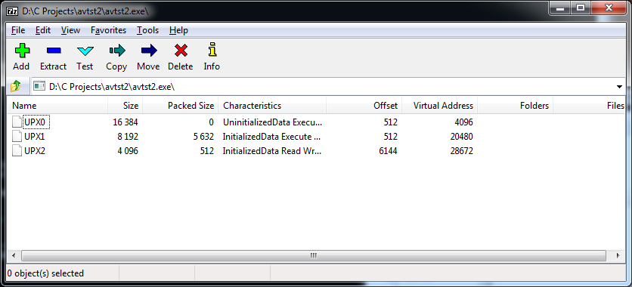
Unpacking p2
Before we start to unpack, let's go over how we identify a program is packed to begin with.
If in IDA we see a bunch of nothing such as hardly any imports, lots of BS in the data section.
We see odd named section headers. One can use 7zip sometimes to view section headers of executables, but generally you can do this with CFF explorer or IDA.
HookAnalyser comes with a decent packer database with something like 4400 different packer signatures.
Hands down the best packer identifier in my opinion is exeinfo. it beats HookAnalyser's db with a grand total of 7075 packer signatures. Not only will it tell you who packed an exe, it will provide a link for how to unpack it. Thanks guys!
Once we know what kind of packer is used (if any) we can begin our unpacking. Be forewarned through, some packers are hard to get around. Really hard. At some point it becomes not worth it in which case we might want to skip the entire reversing process from a debugger level and instead opt for the live analysis tools to save time and a major migrane. Don't feel bad if you can't get around a packer, it happens to me from time to time.

Slide 23
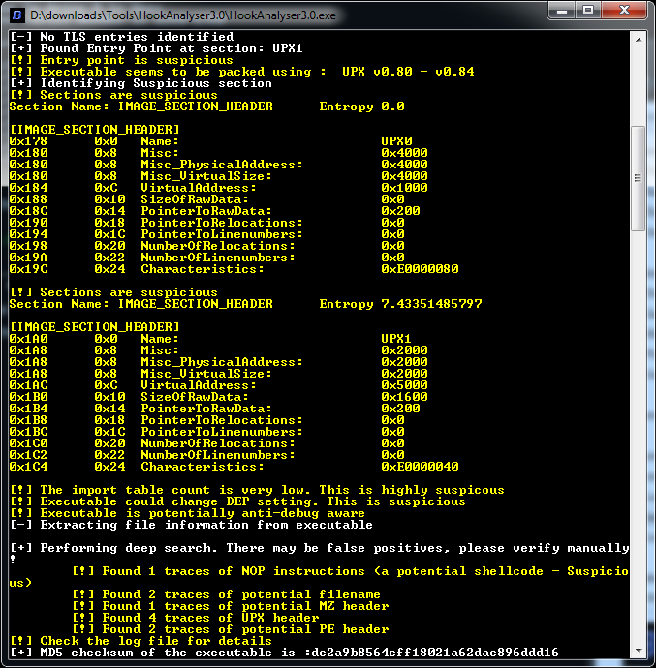
Unpacking p3
Pic on the left demonstrates HookAnalyzer running an analysis on a UPX packed binary. It’s not a perfect tool, if you’ll notice the false positive of supposed NOP instructions. The nice thing about HookAnalyser is it will extract IP addresses for you automatically – very useful for malware analysis.

Slide 24
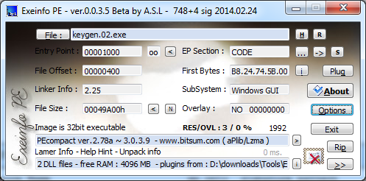
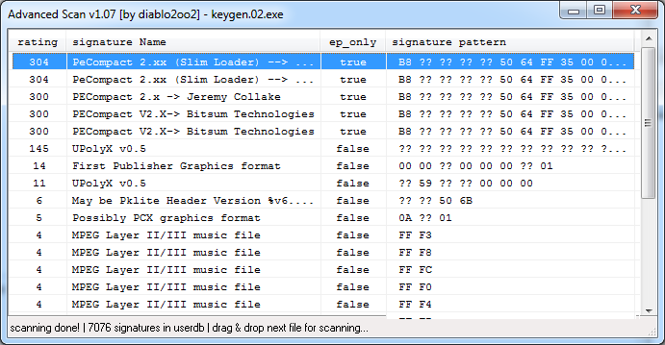
Unpacking p4
When it comes to identifying packers, there is no tool better than exeinfo, second only to experience.
It has a packer database with which it searches through, can scan for media files, IP addresses, hostnames, and all that other good stuff.
And its free which makes it #1.

Slide 25
Unpacking demonstration
Fire up your debuggers. We’ll be going over the ‘Local-Appwizard.exe’ file in the ‘Samples’ folder.

Slide 26
Dynamic Analysis
For when you either a) don’t care about the inner workings and only want basic info from the malware or b) malware packed /encrypted tight and you cant get around it.
This is where proper usage of procmon / wireshark / cuckoo are a godsend. Even if a program’s assembly code isn’t available, we can still see what its doing and probe it blackbox style.

Slide 27
Memory Analysis
HookAnalyzer and Volatility are excellent memory analysis tools. HookAnalyzer will do it live, but Volatility requires a memory dump and has to be done post execution.
Process Hacker allows you to dump a running process’s memory for inspection and allows for filtering and searching. The same can be done via your debugger, but this isn’t always feasible.

Slide 28
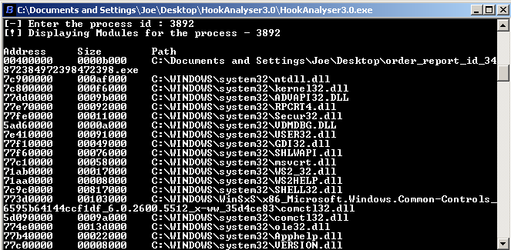
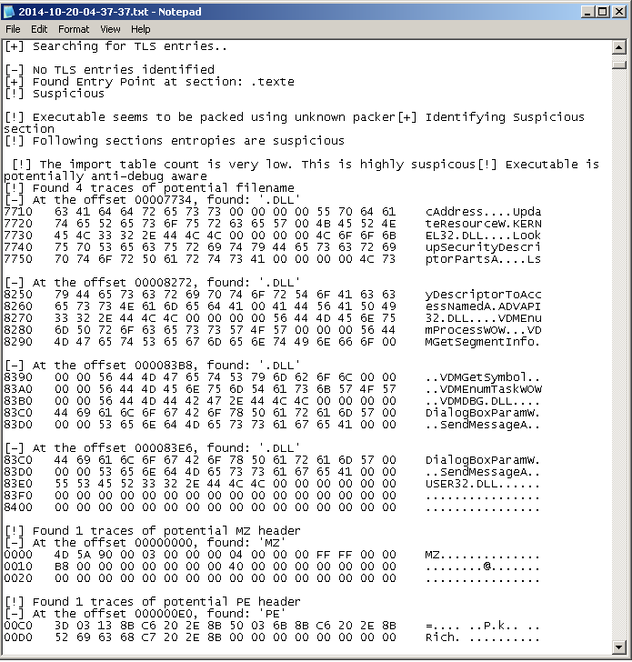
Hook Analyser
This tool supports live memory analysis of running processes This makes it indispensable.

Slide 29
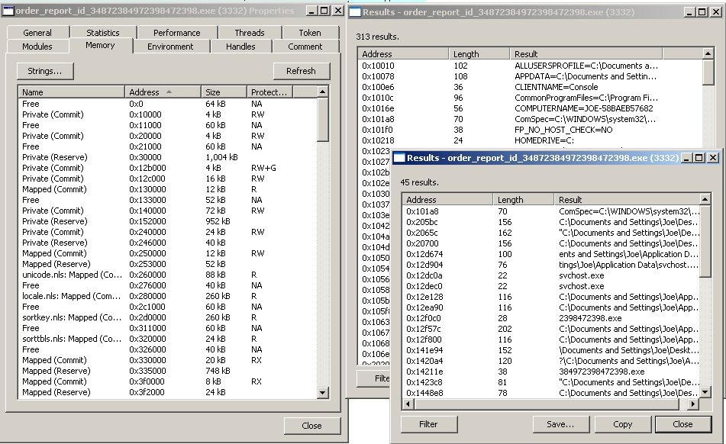
Process Hacker
Another must have useful tool. Capable of live memory searching and dumping, it provides things taskmanager should but doesn’t including disk IO monitoring and networking activity monitoring capabilities.

Slide 30
Volatility In Action
<video of me using volatility or I’ll do it live>

Slide 31
Where Do I Get Malware?
http://www.offensivecomputing.net/
IRC
Reddit / 4chan / Tumblr
me (joe@gironsec.com),
Twitter #malwaremustdie
AV companies
http://syrianmalware.net
Torrents / cracked software / gnutella network.
Spam email

Slide 32
Help! I’m stuck ☹
If you ever get stuck on a sample, fear not. There are communities out there that deal with malware forensics. Reddit, Exeforums, woodman, kernelmode.info, mailing lists, and even twitter are excellent sources full of people who will help. Even IRC still works.

Slide 33
Additional Resources
https://code.google.com/p/corkami/
^^ An excellent resource for info on reversing
http://www.woodmann.com/collaborative/tools/index.php/Category:RCE_Tools
^^ huge resource for reverse engineering tools
http://reddit.com/r/ReverseEngineering/
^^ Still better than /r/malware. Avoid /r/malware
http://gironsec.com/blog/
^^ shameless self promotion? No, I got plenty of good guides!

Slide 34
Questions?

Slide 35
Contact Info
Name: Joe Giron
Email: Joe@gironsec.com
Phone: 512-902-3787

